Slide 1

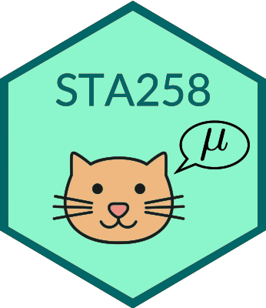
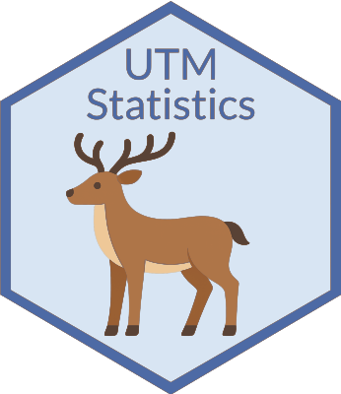
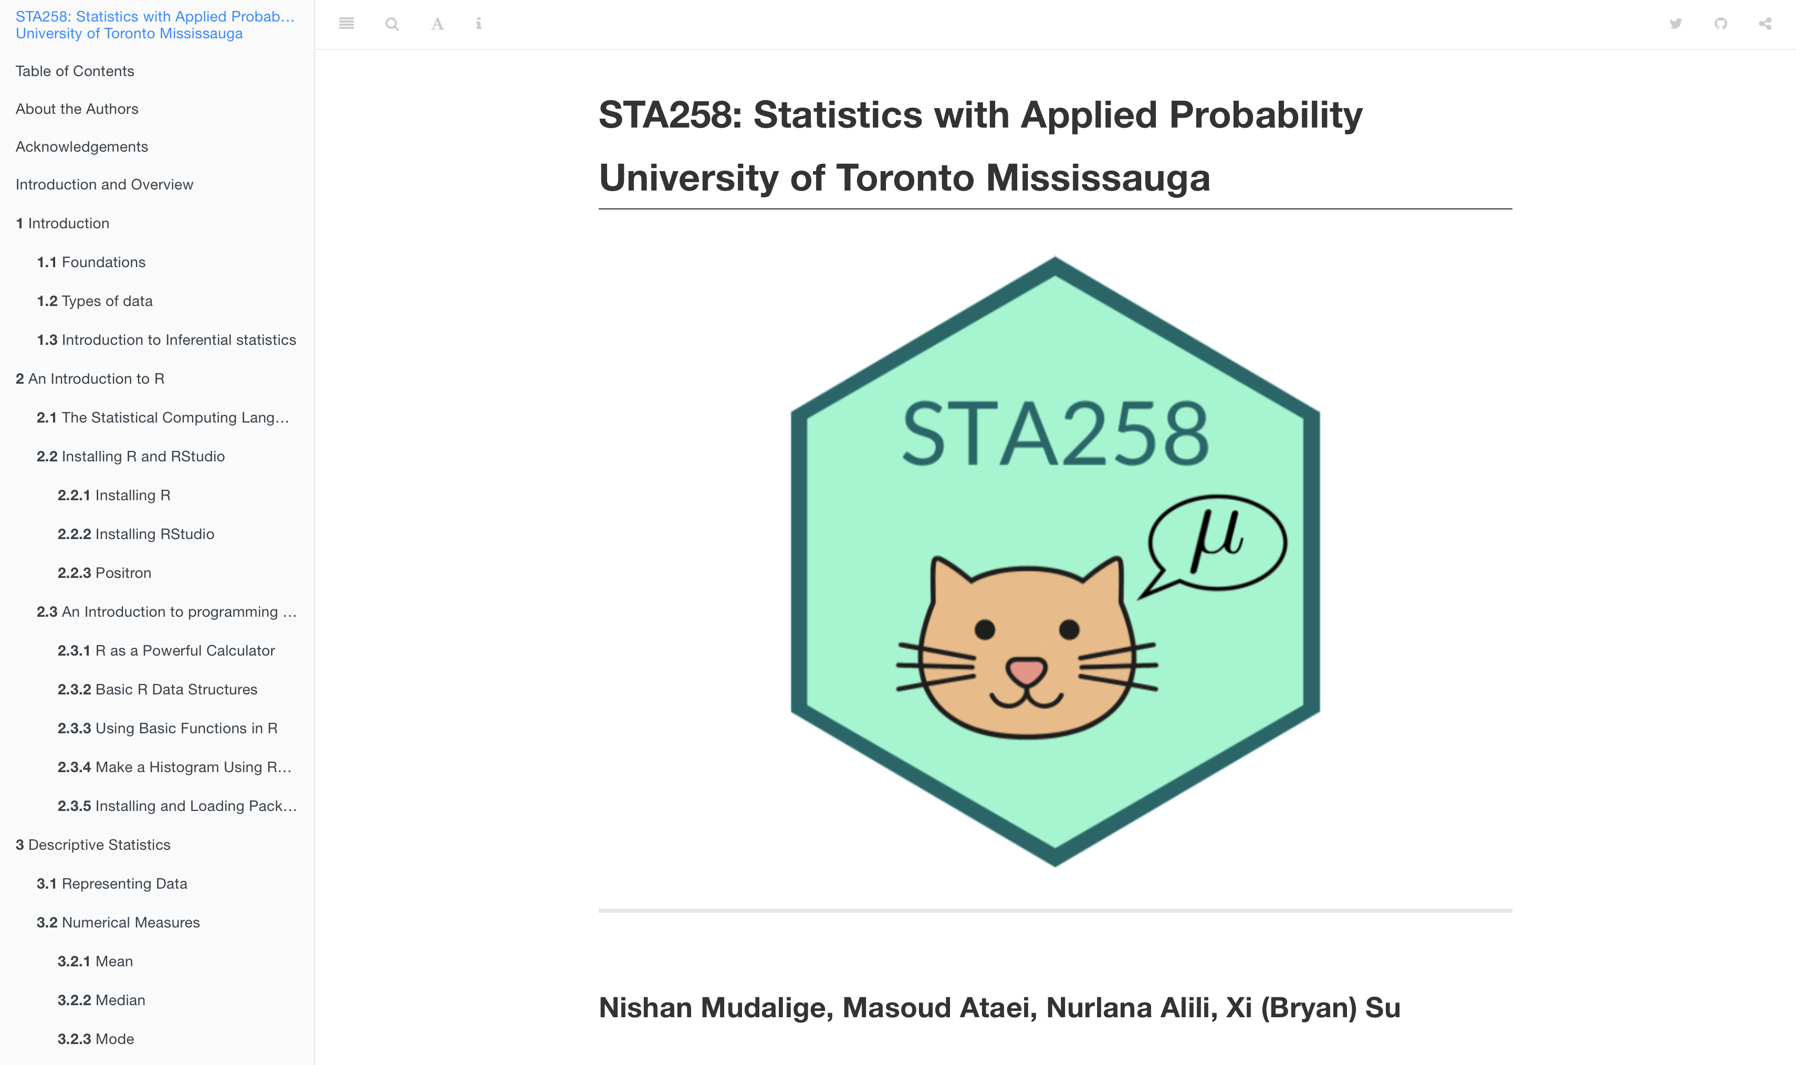
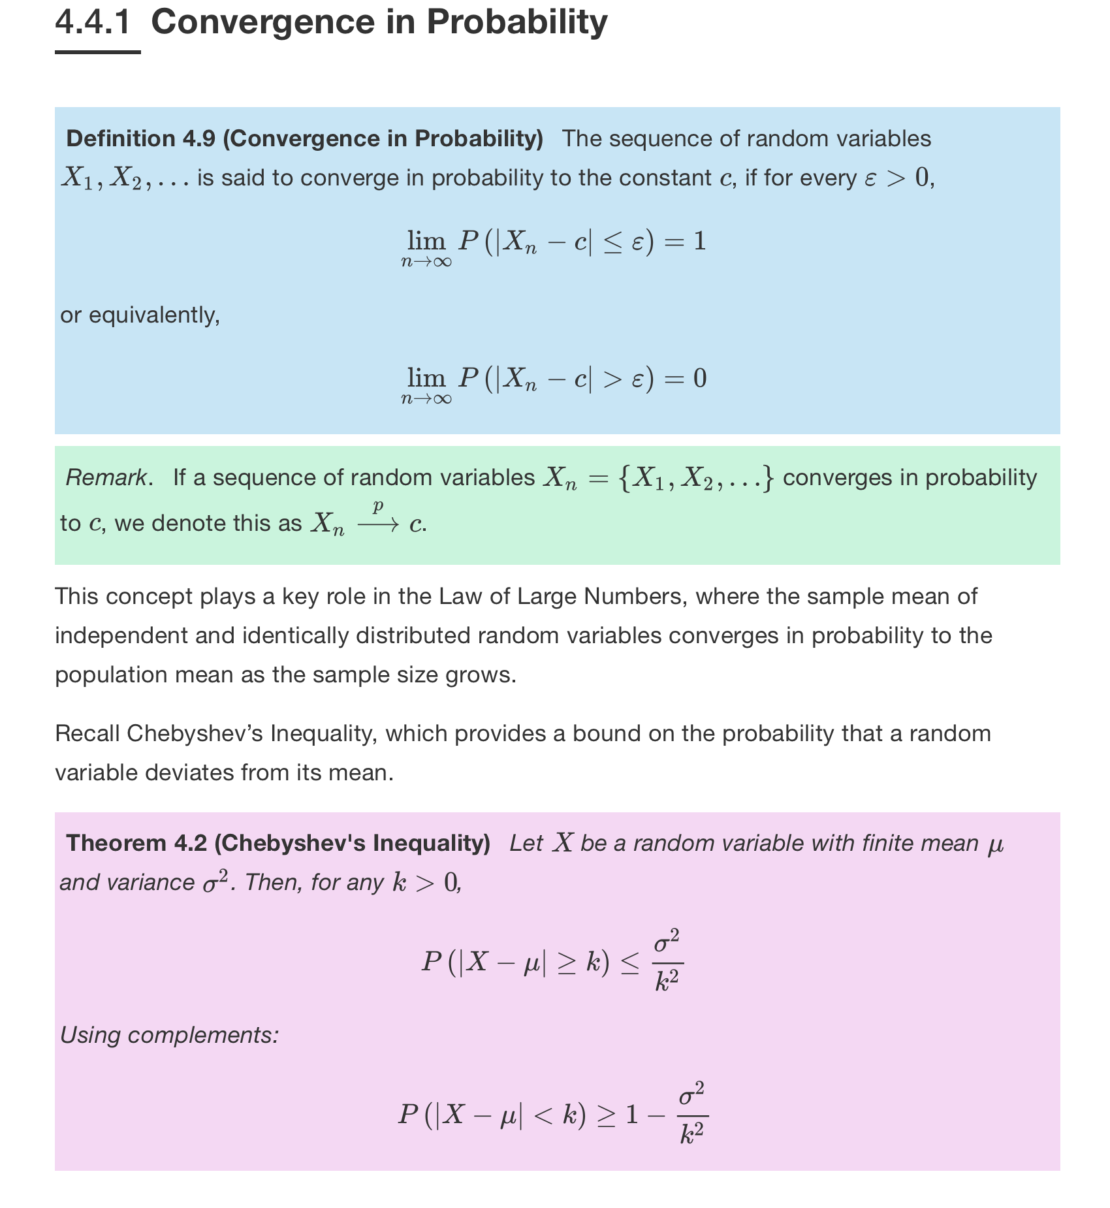
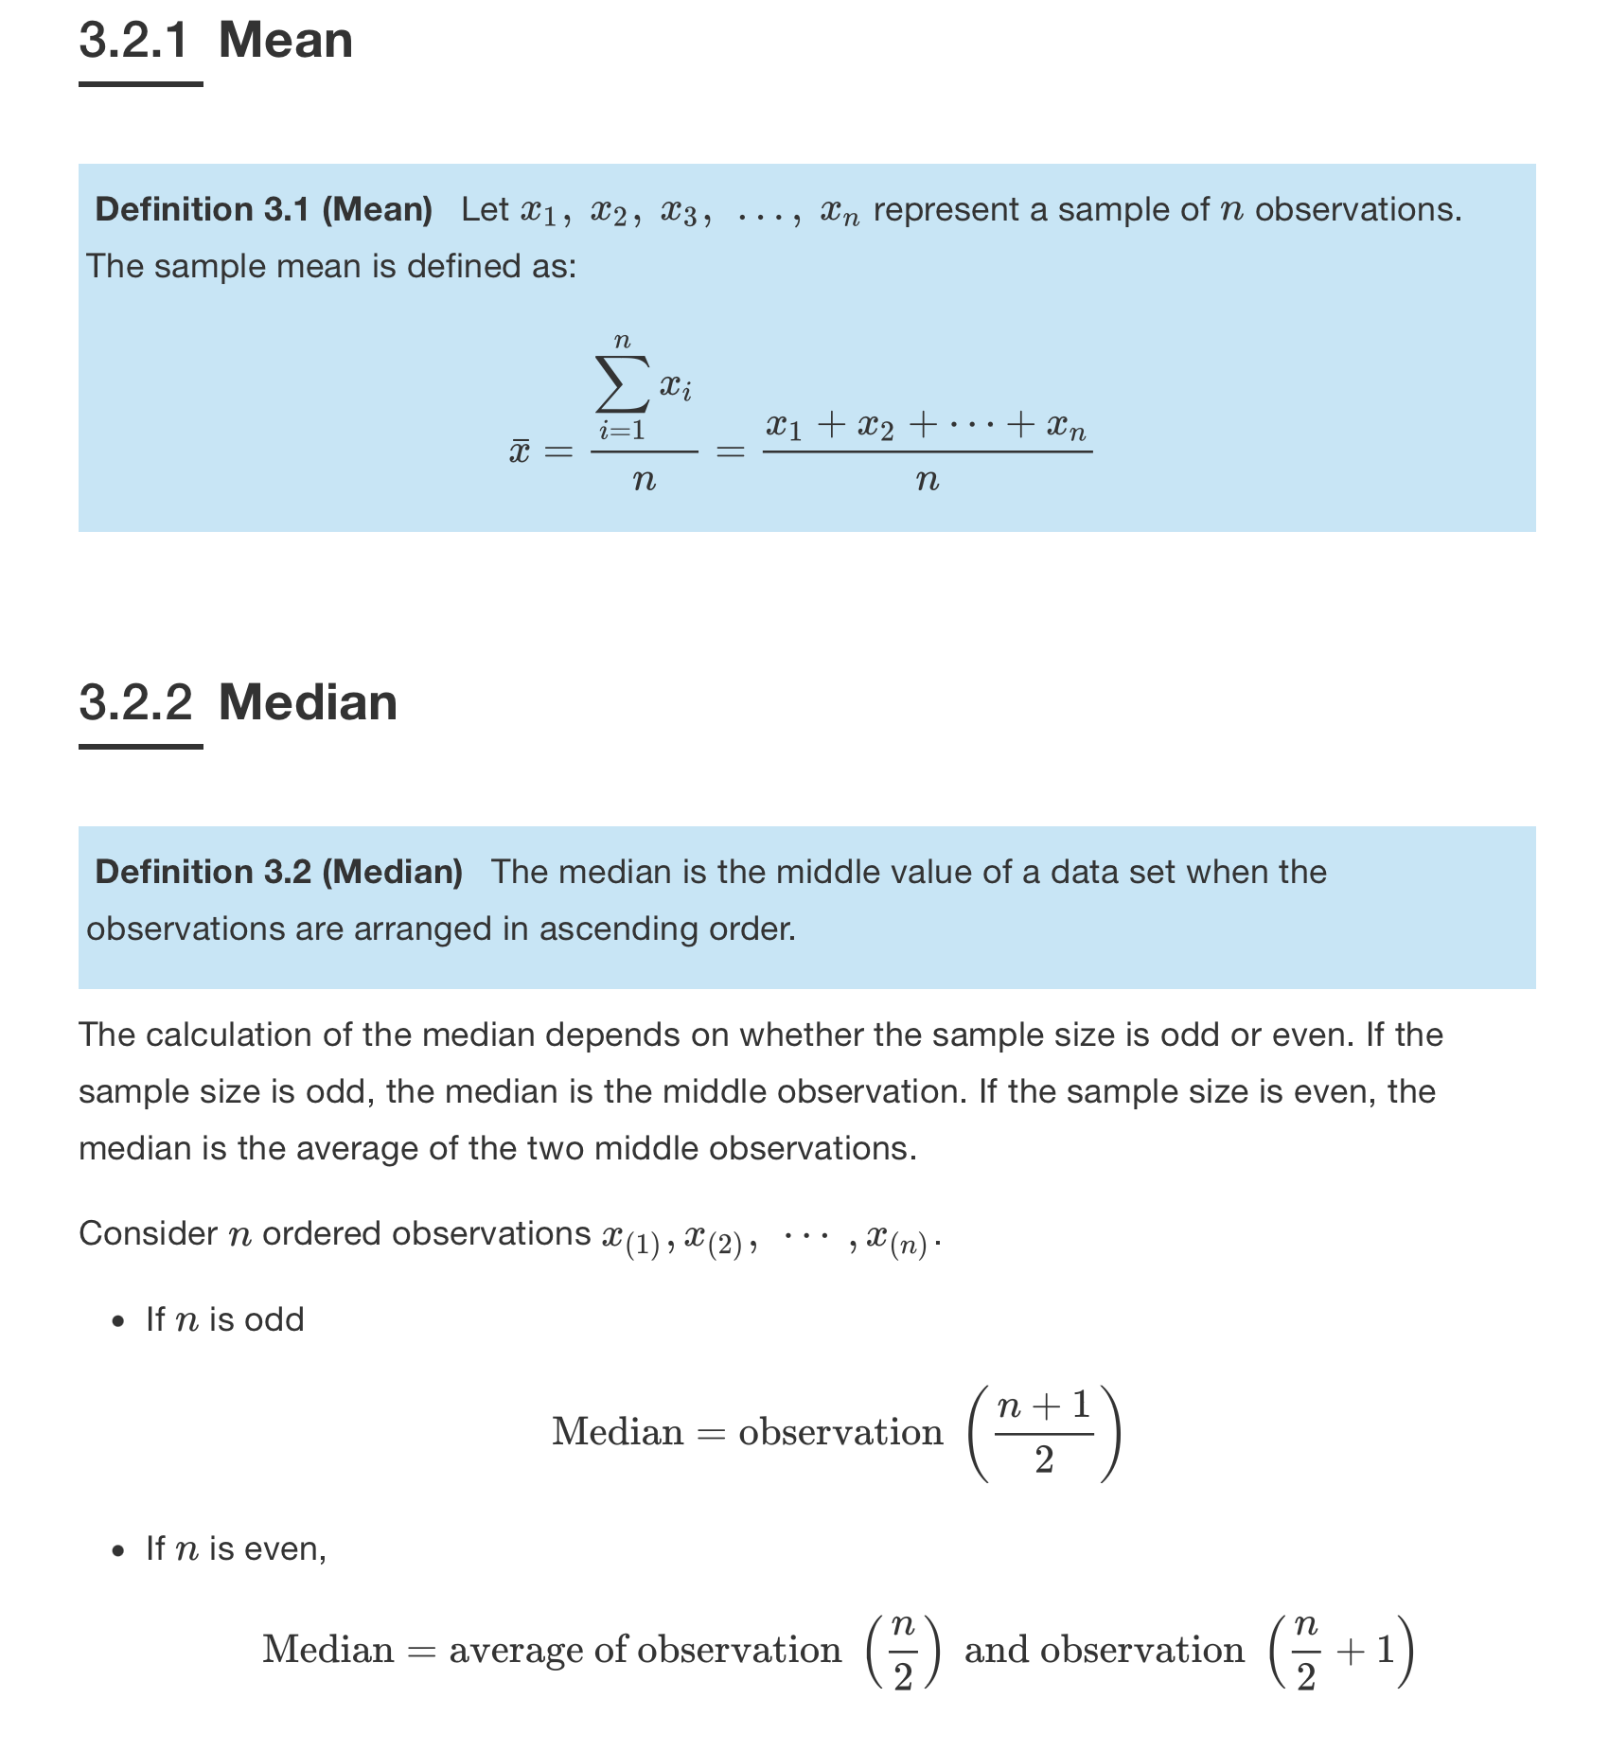
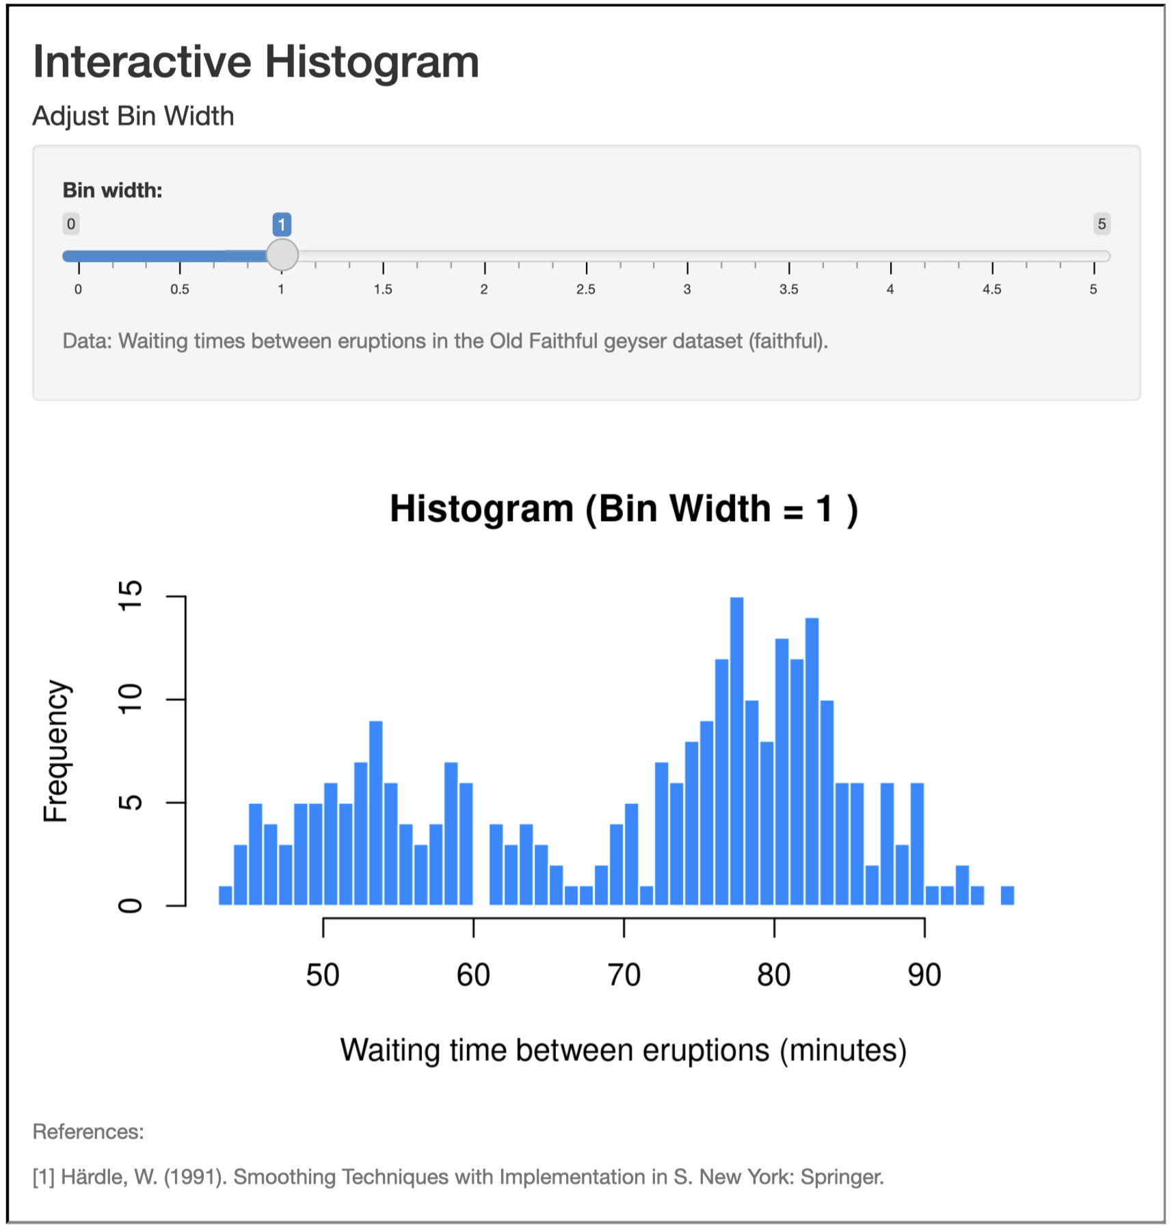
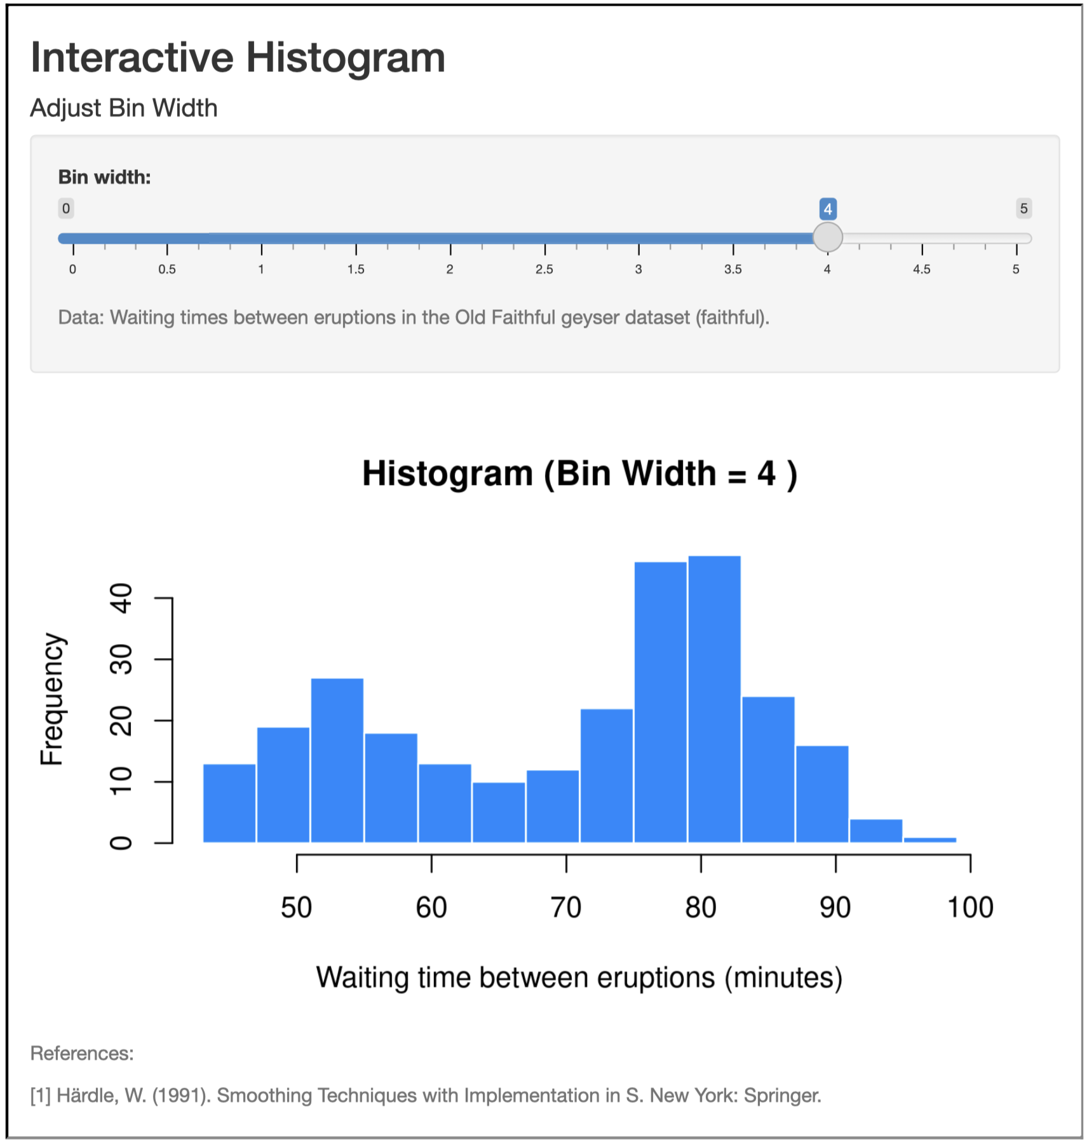
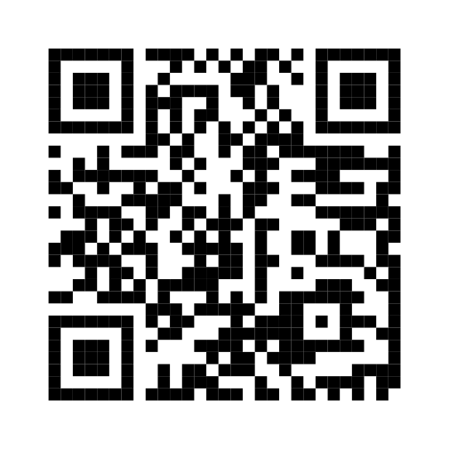
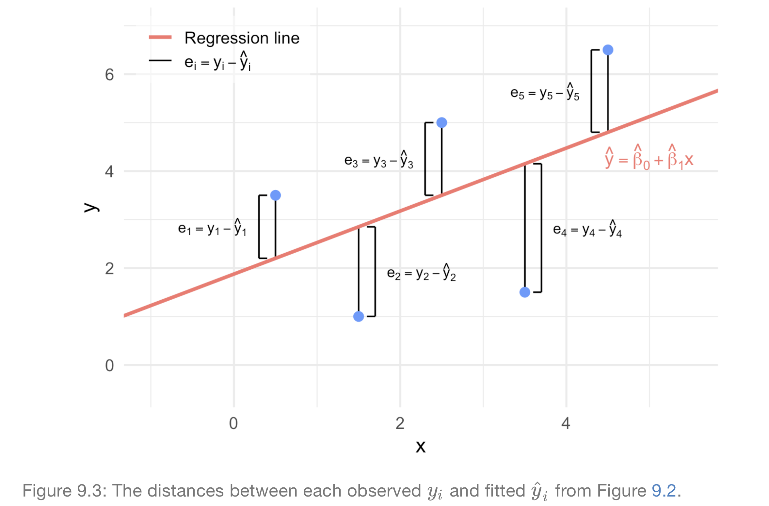
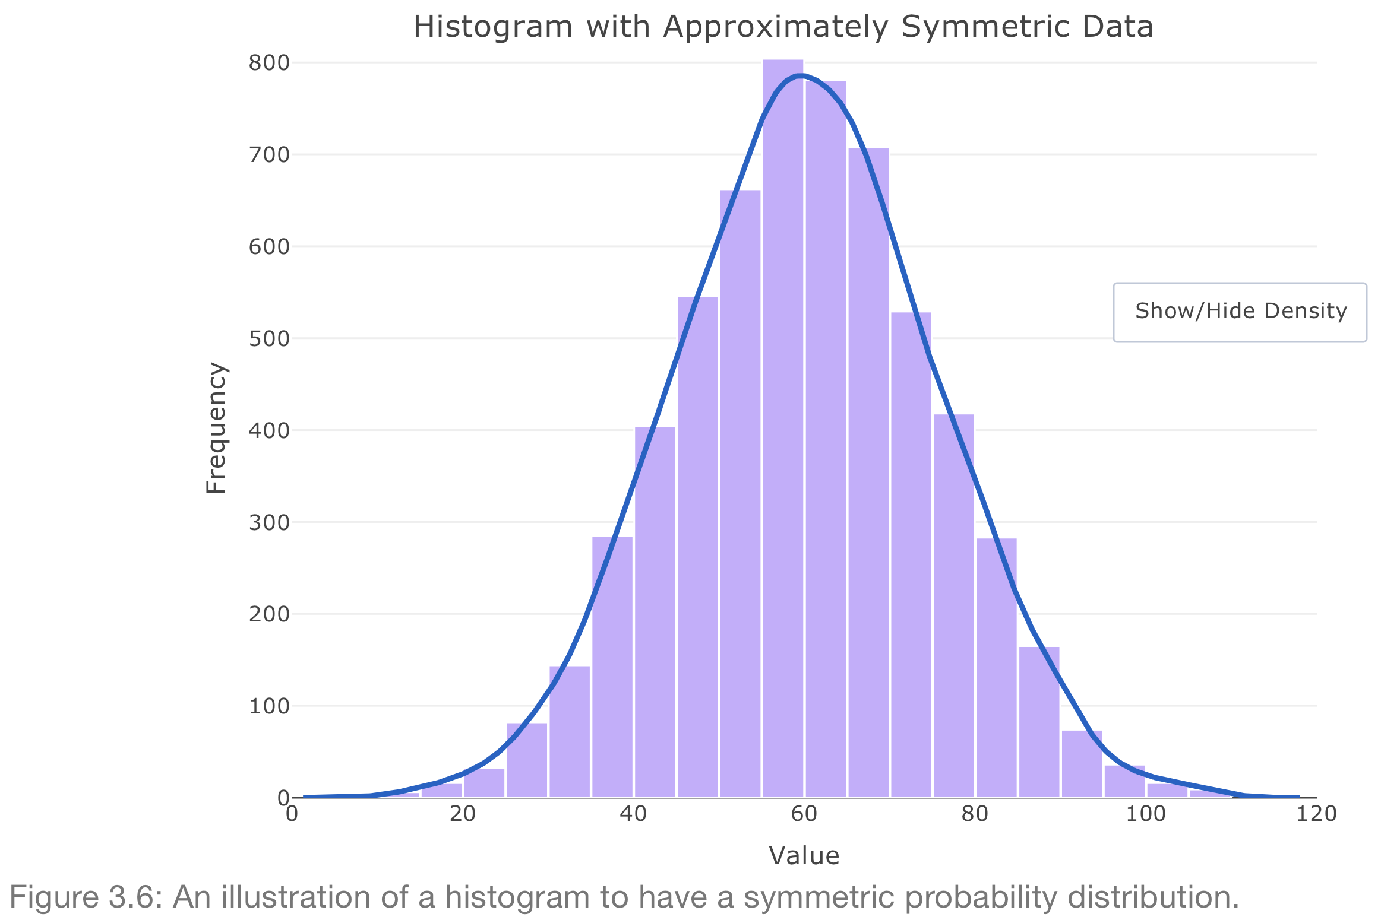
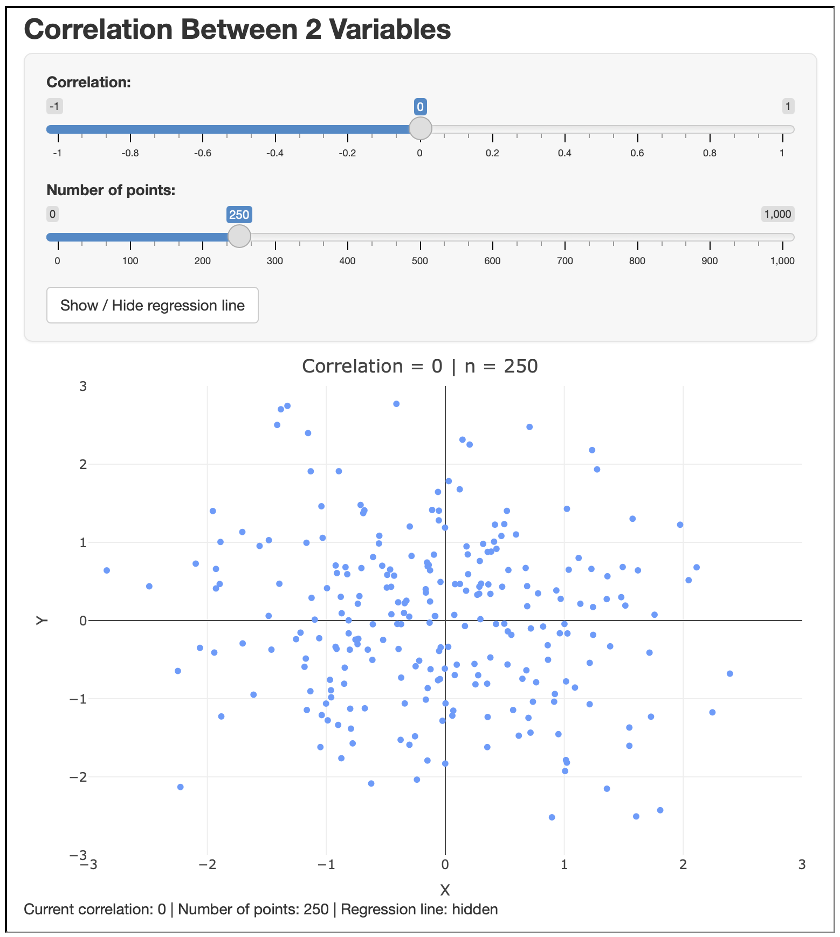
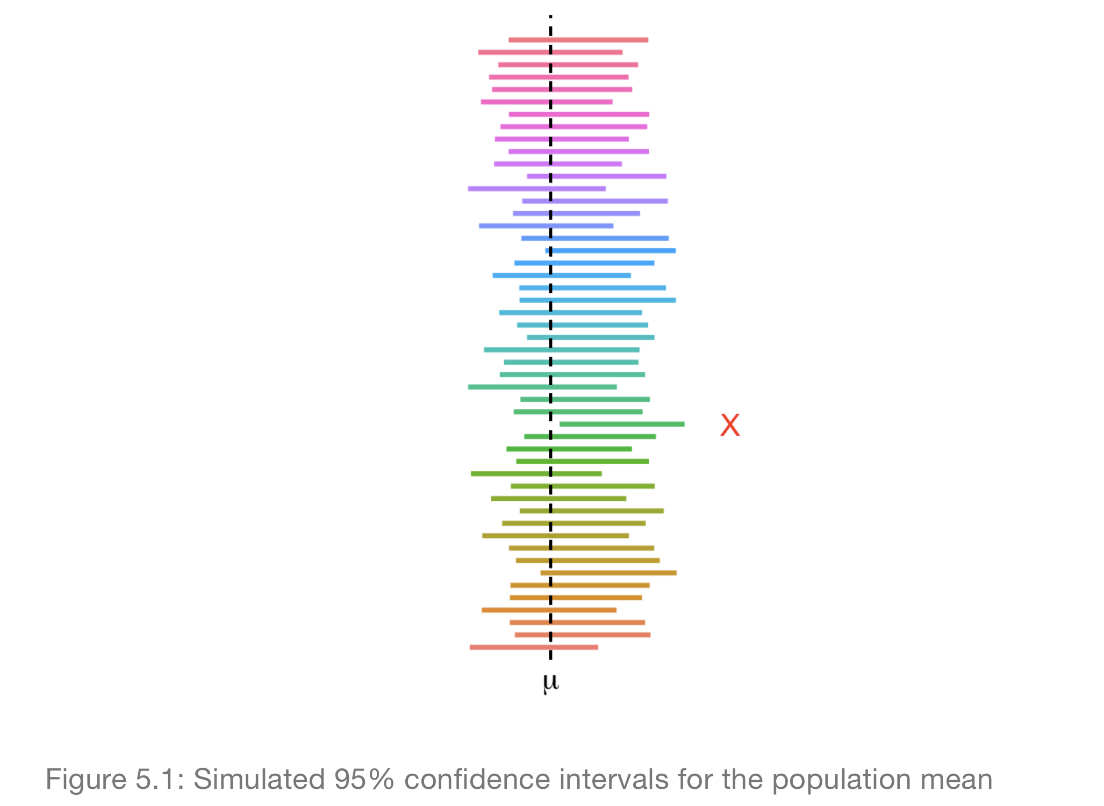
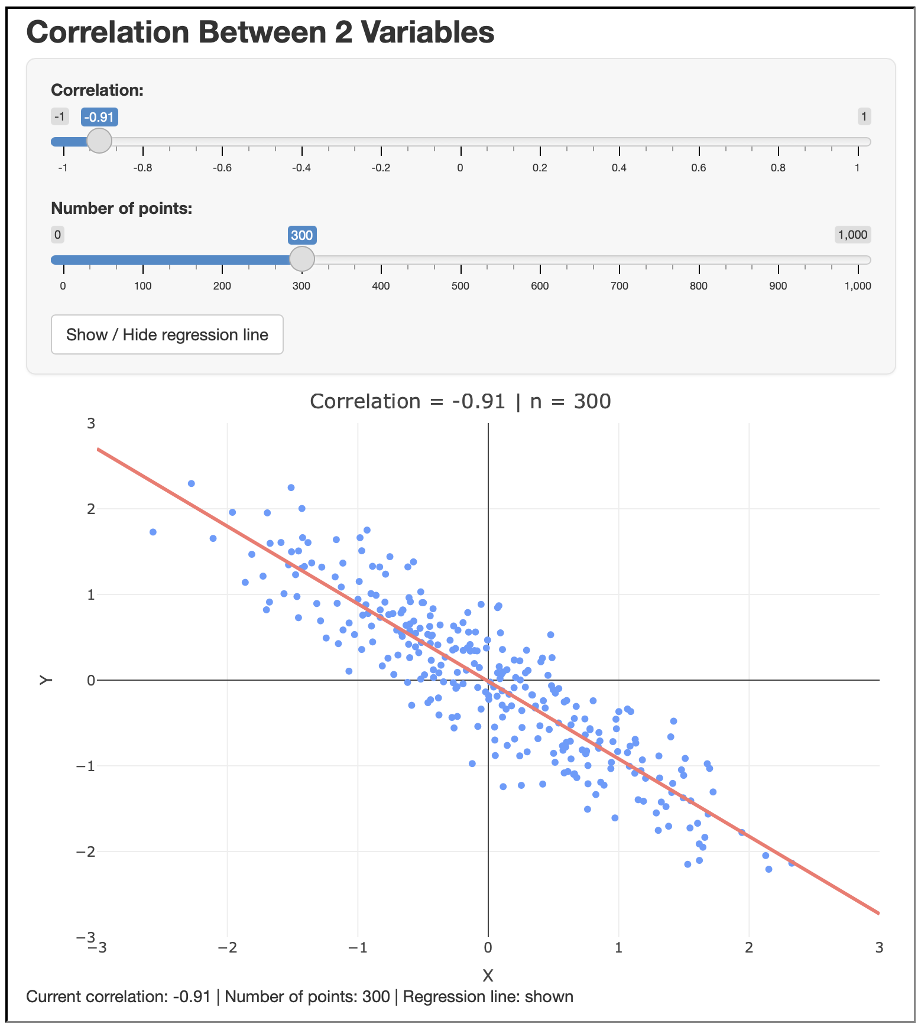
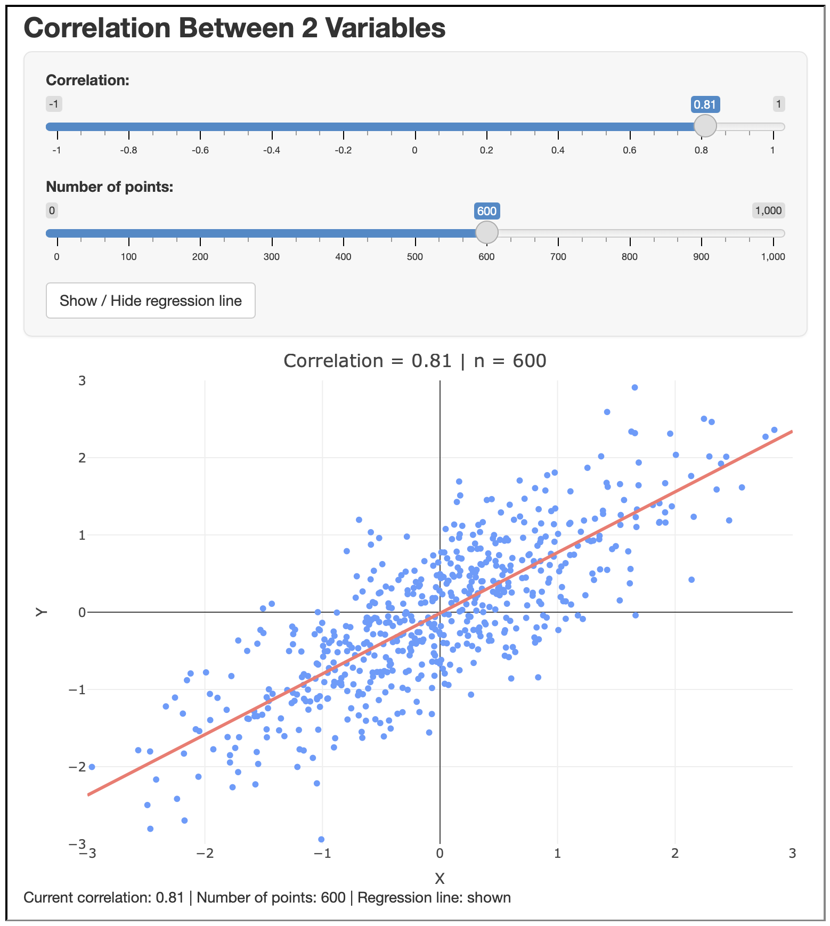
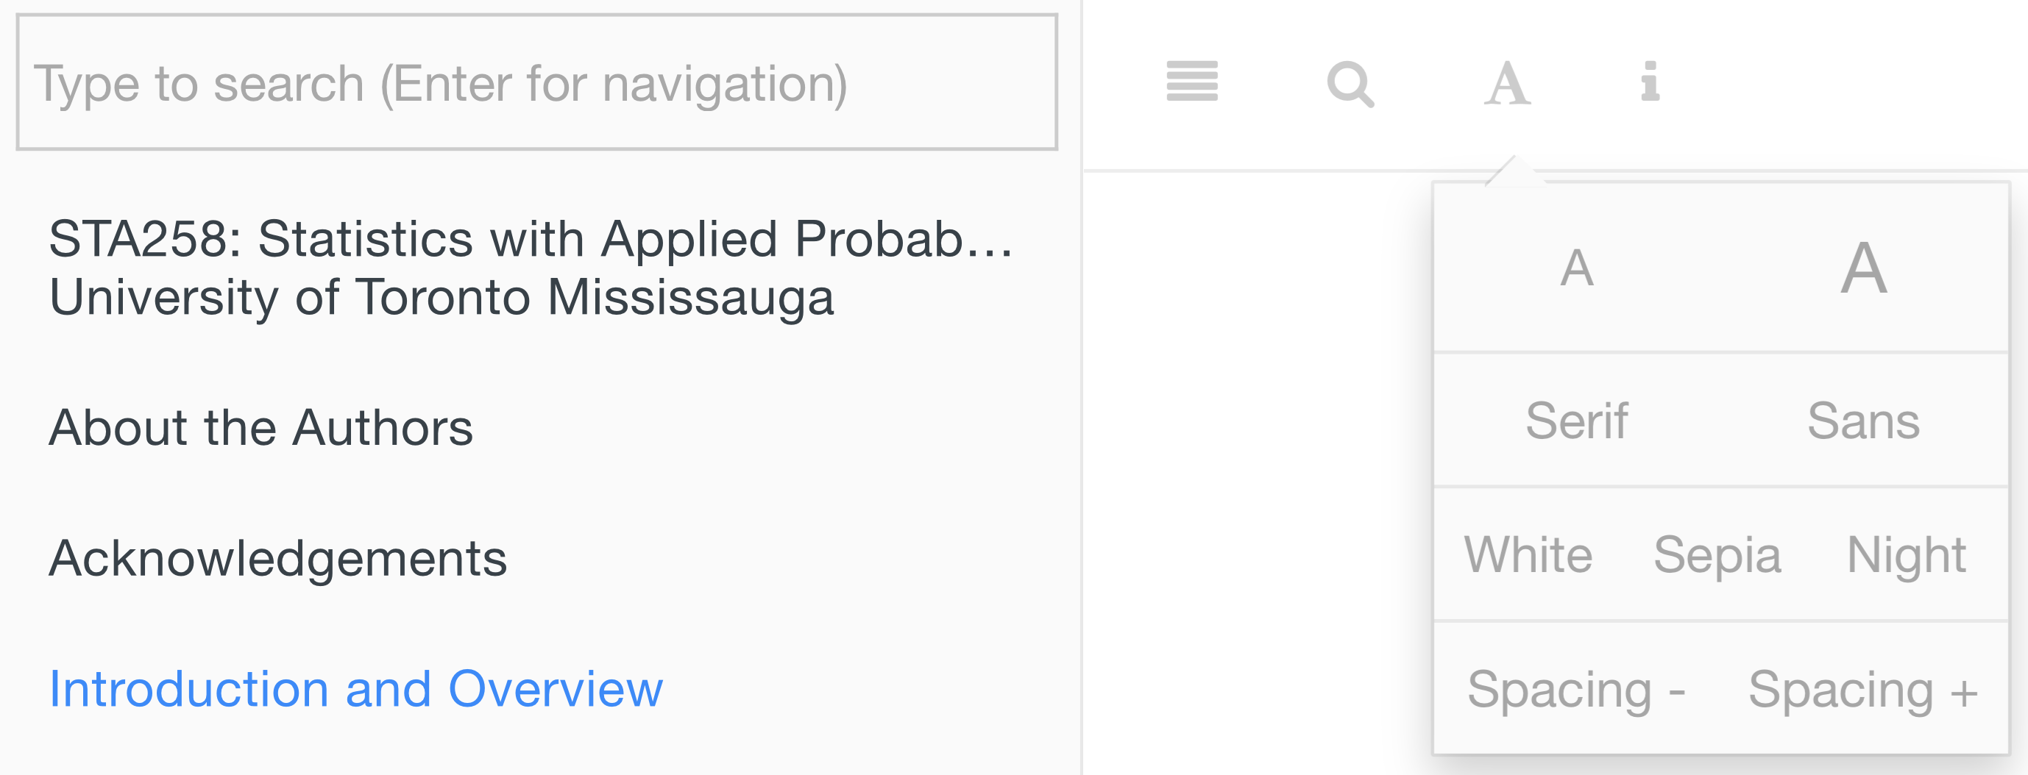
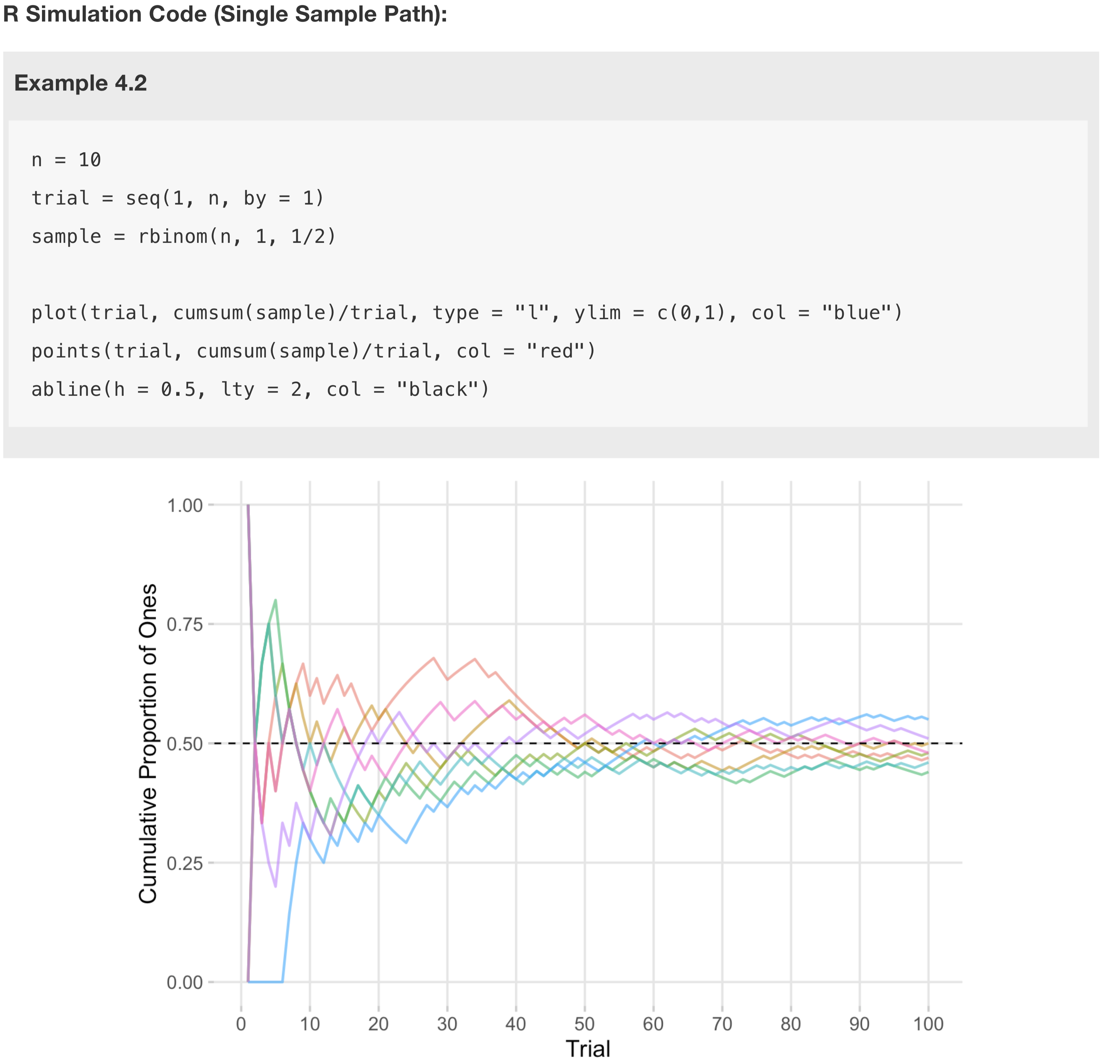
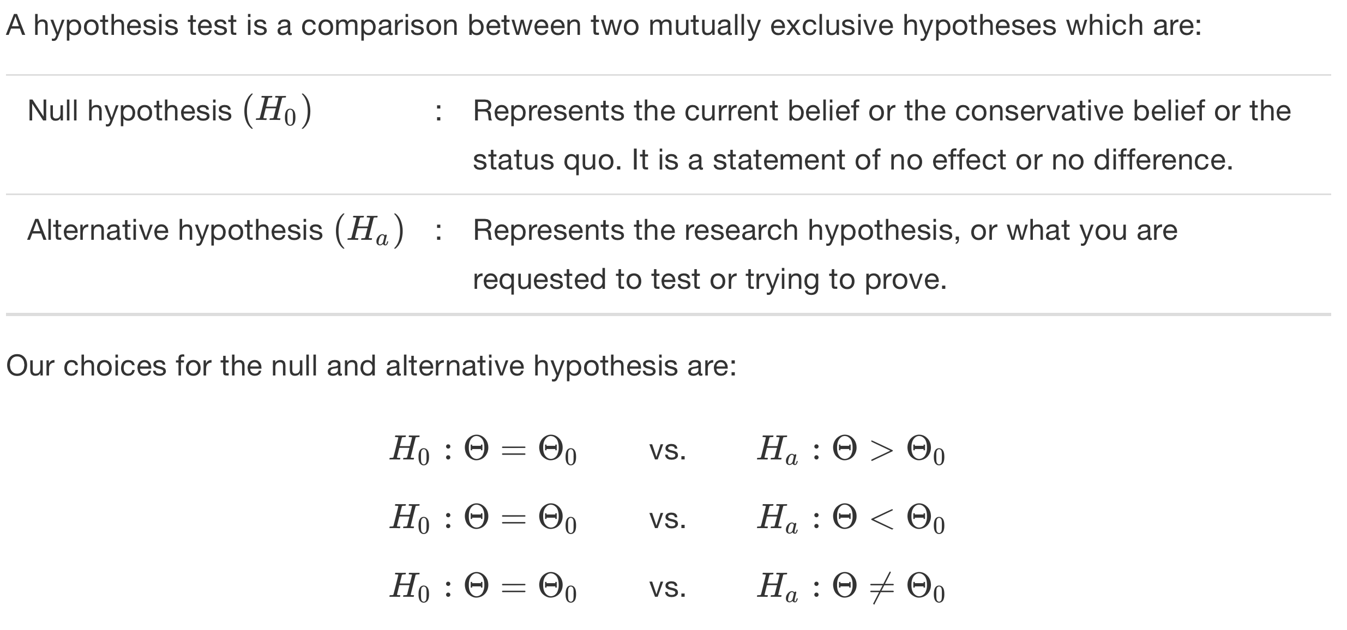
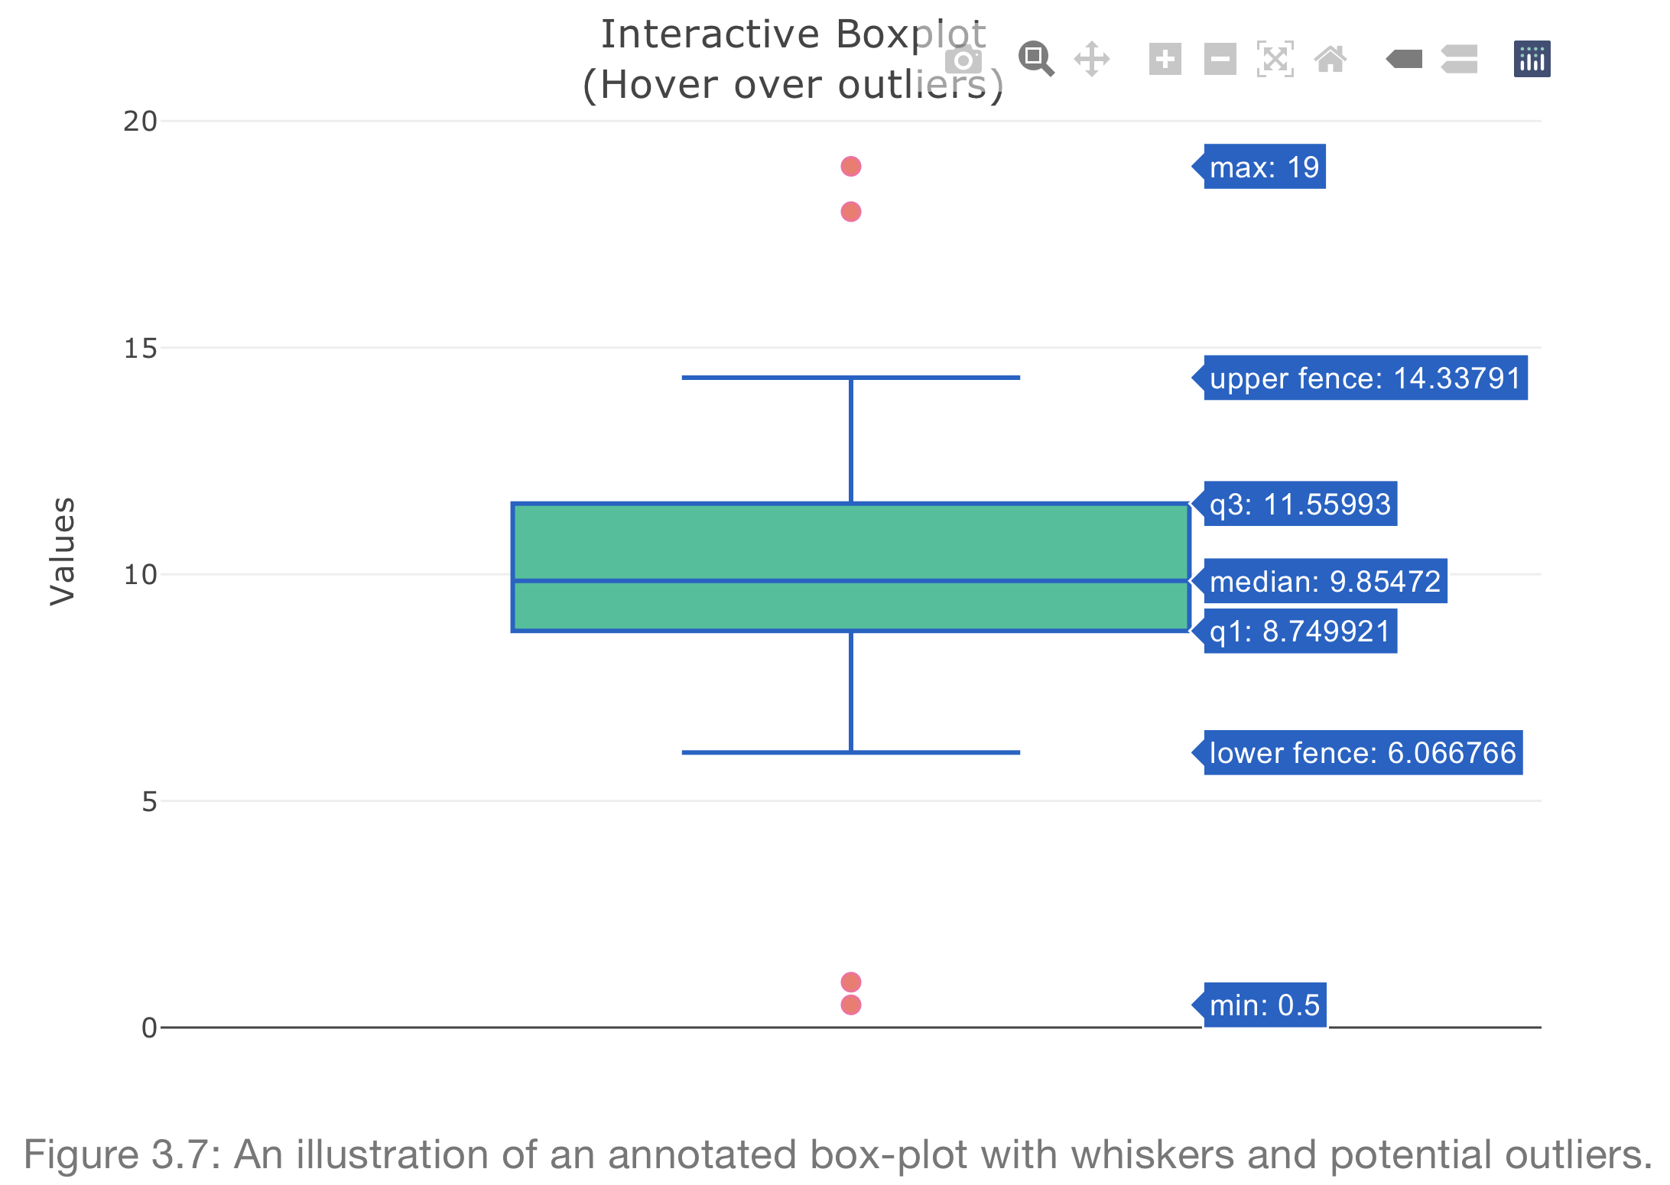
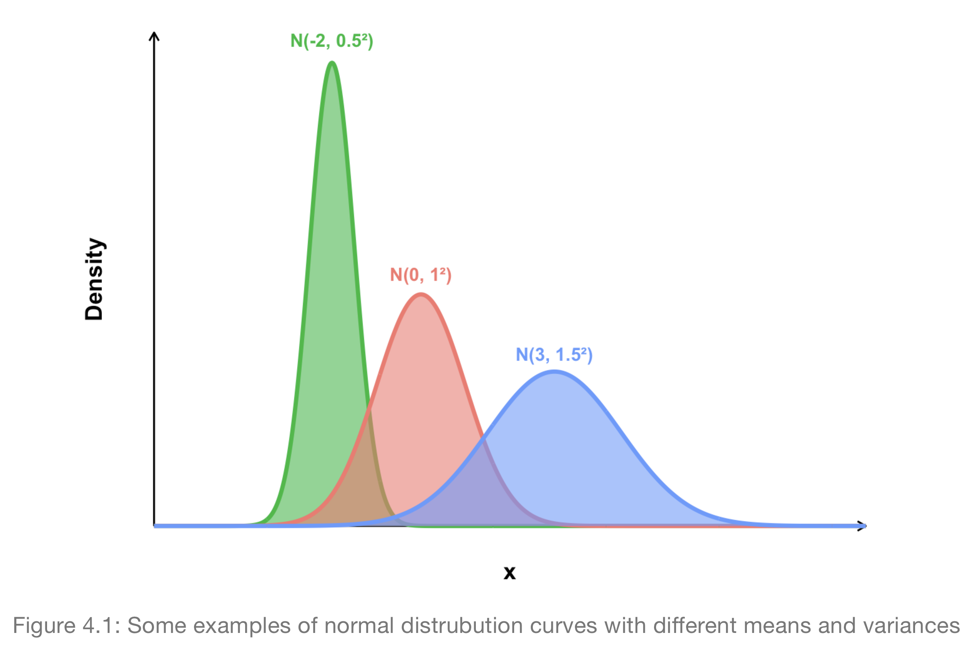
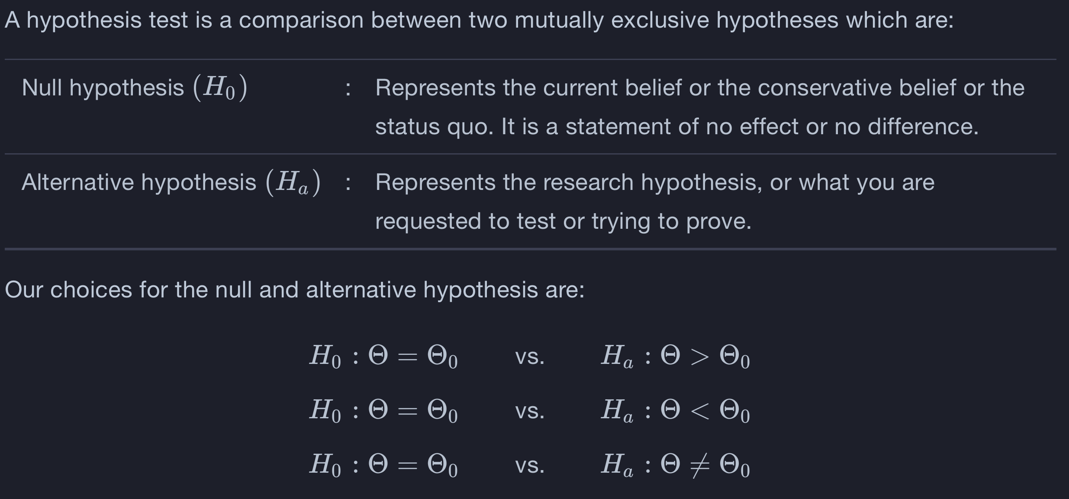
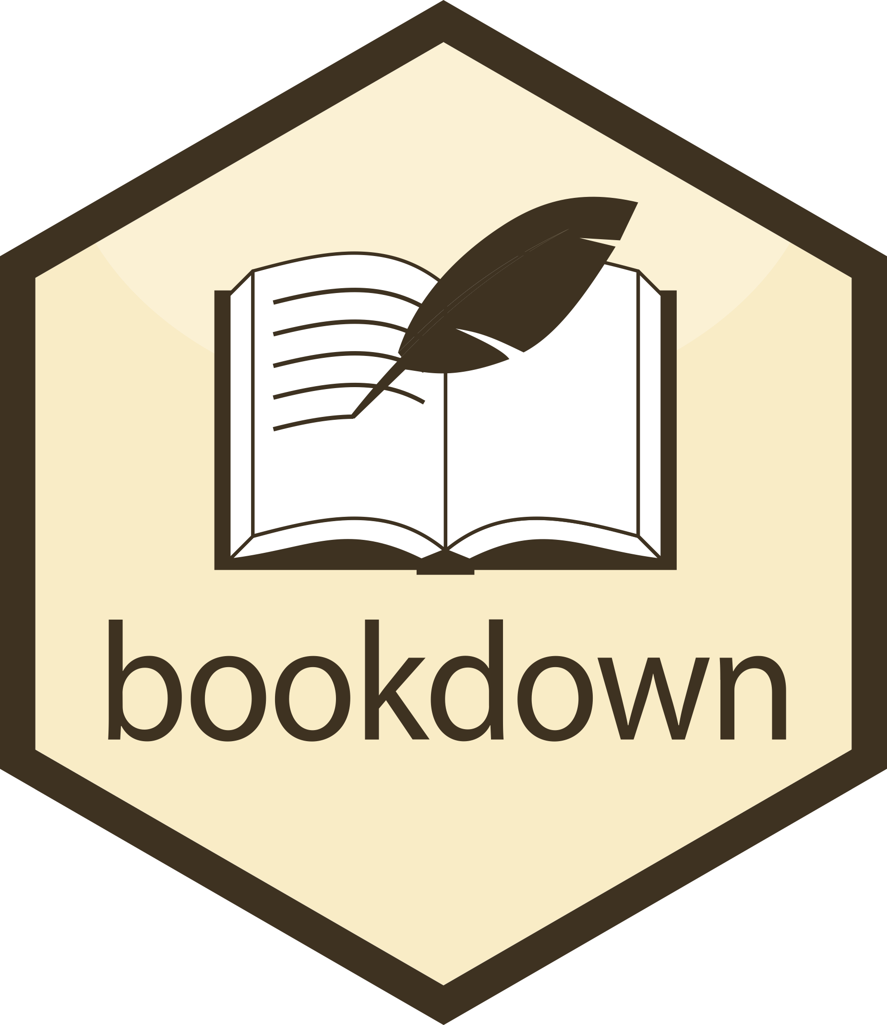
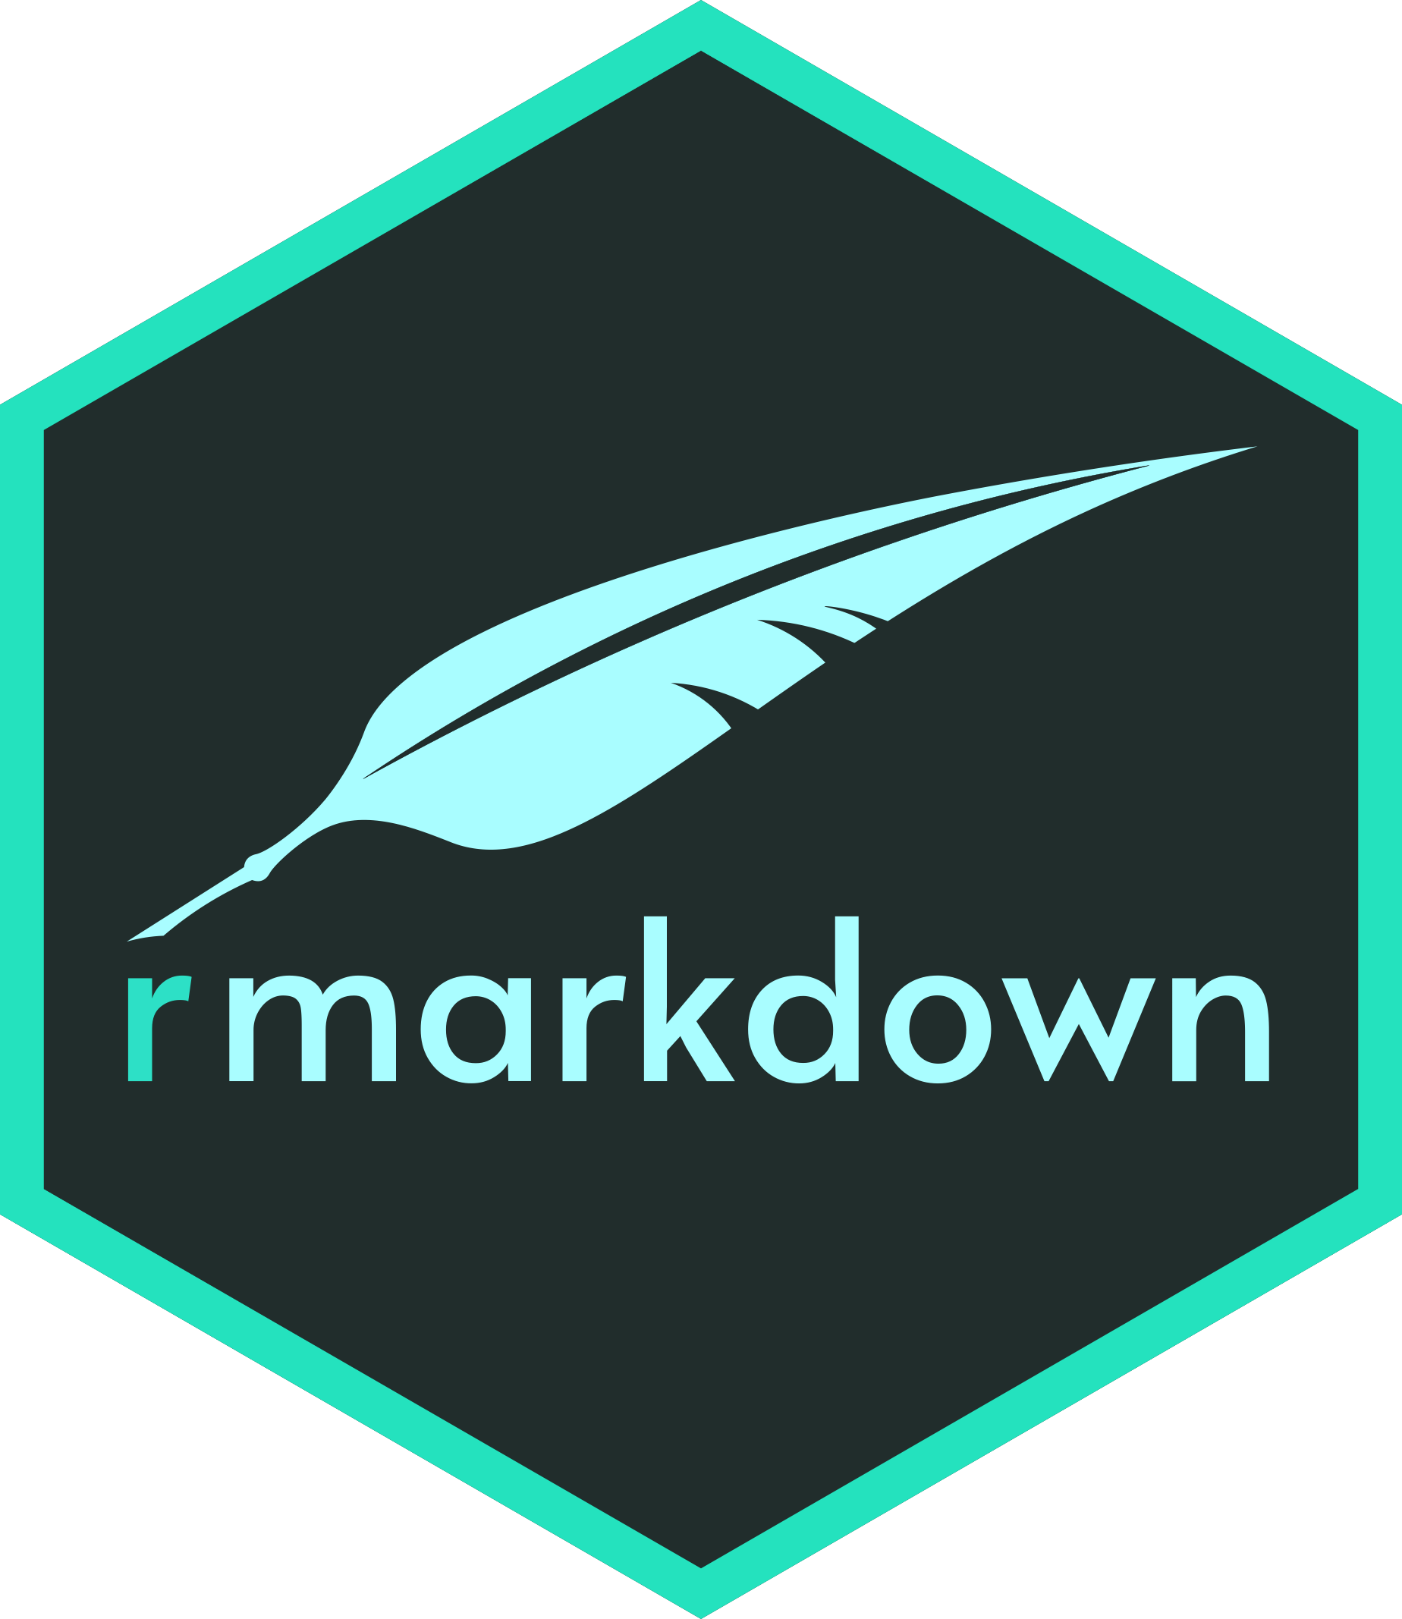
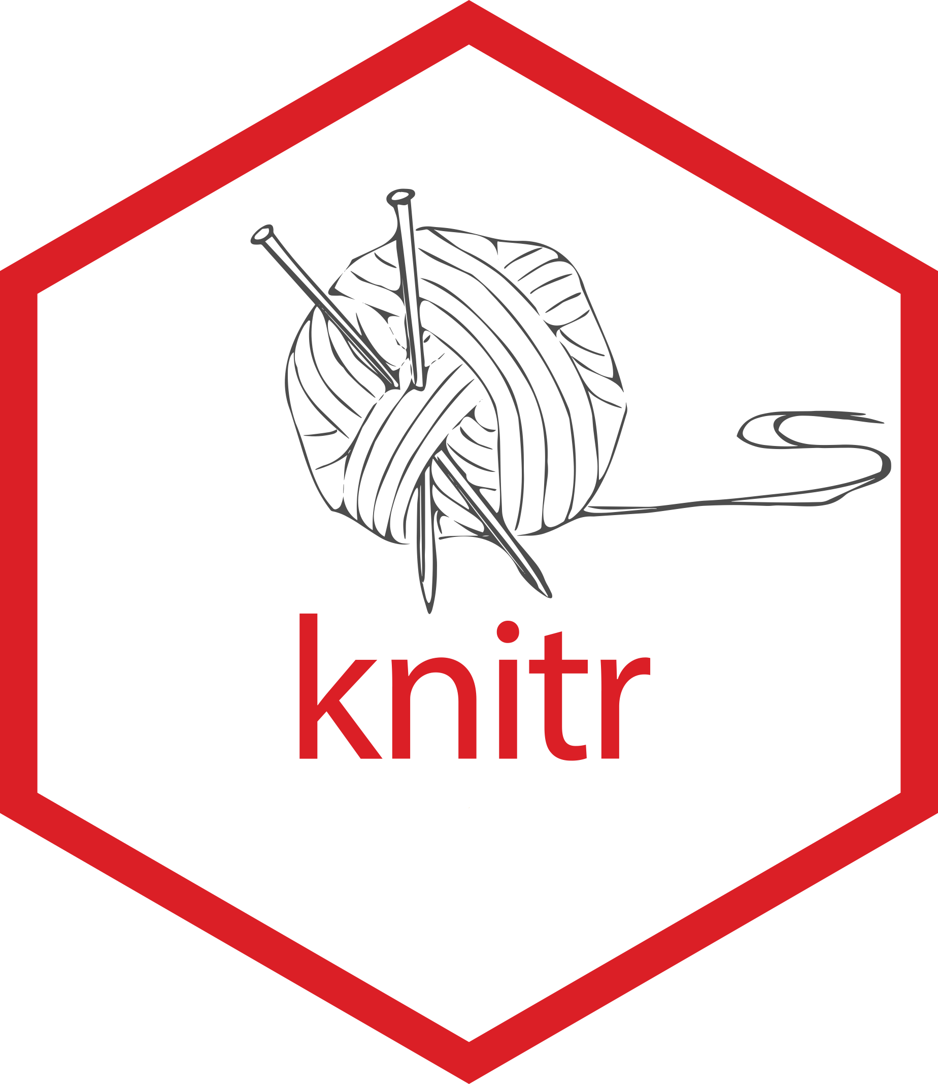
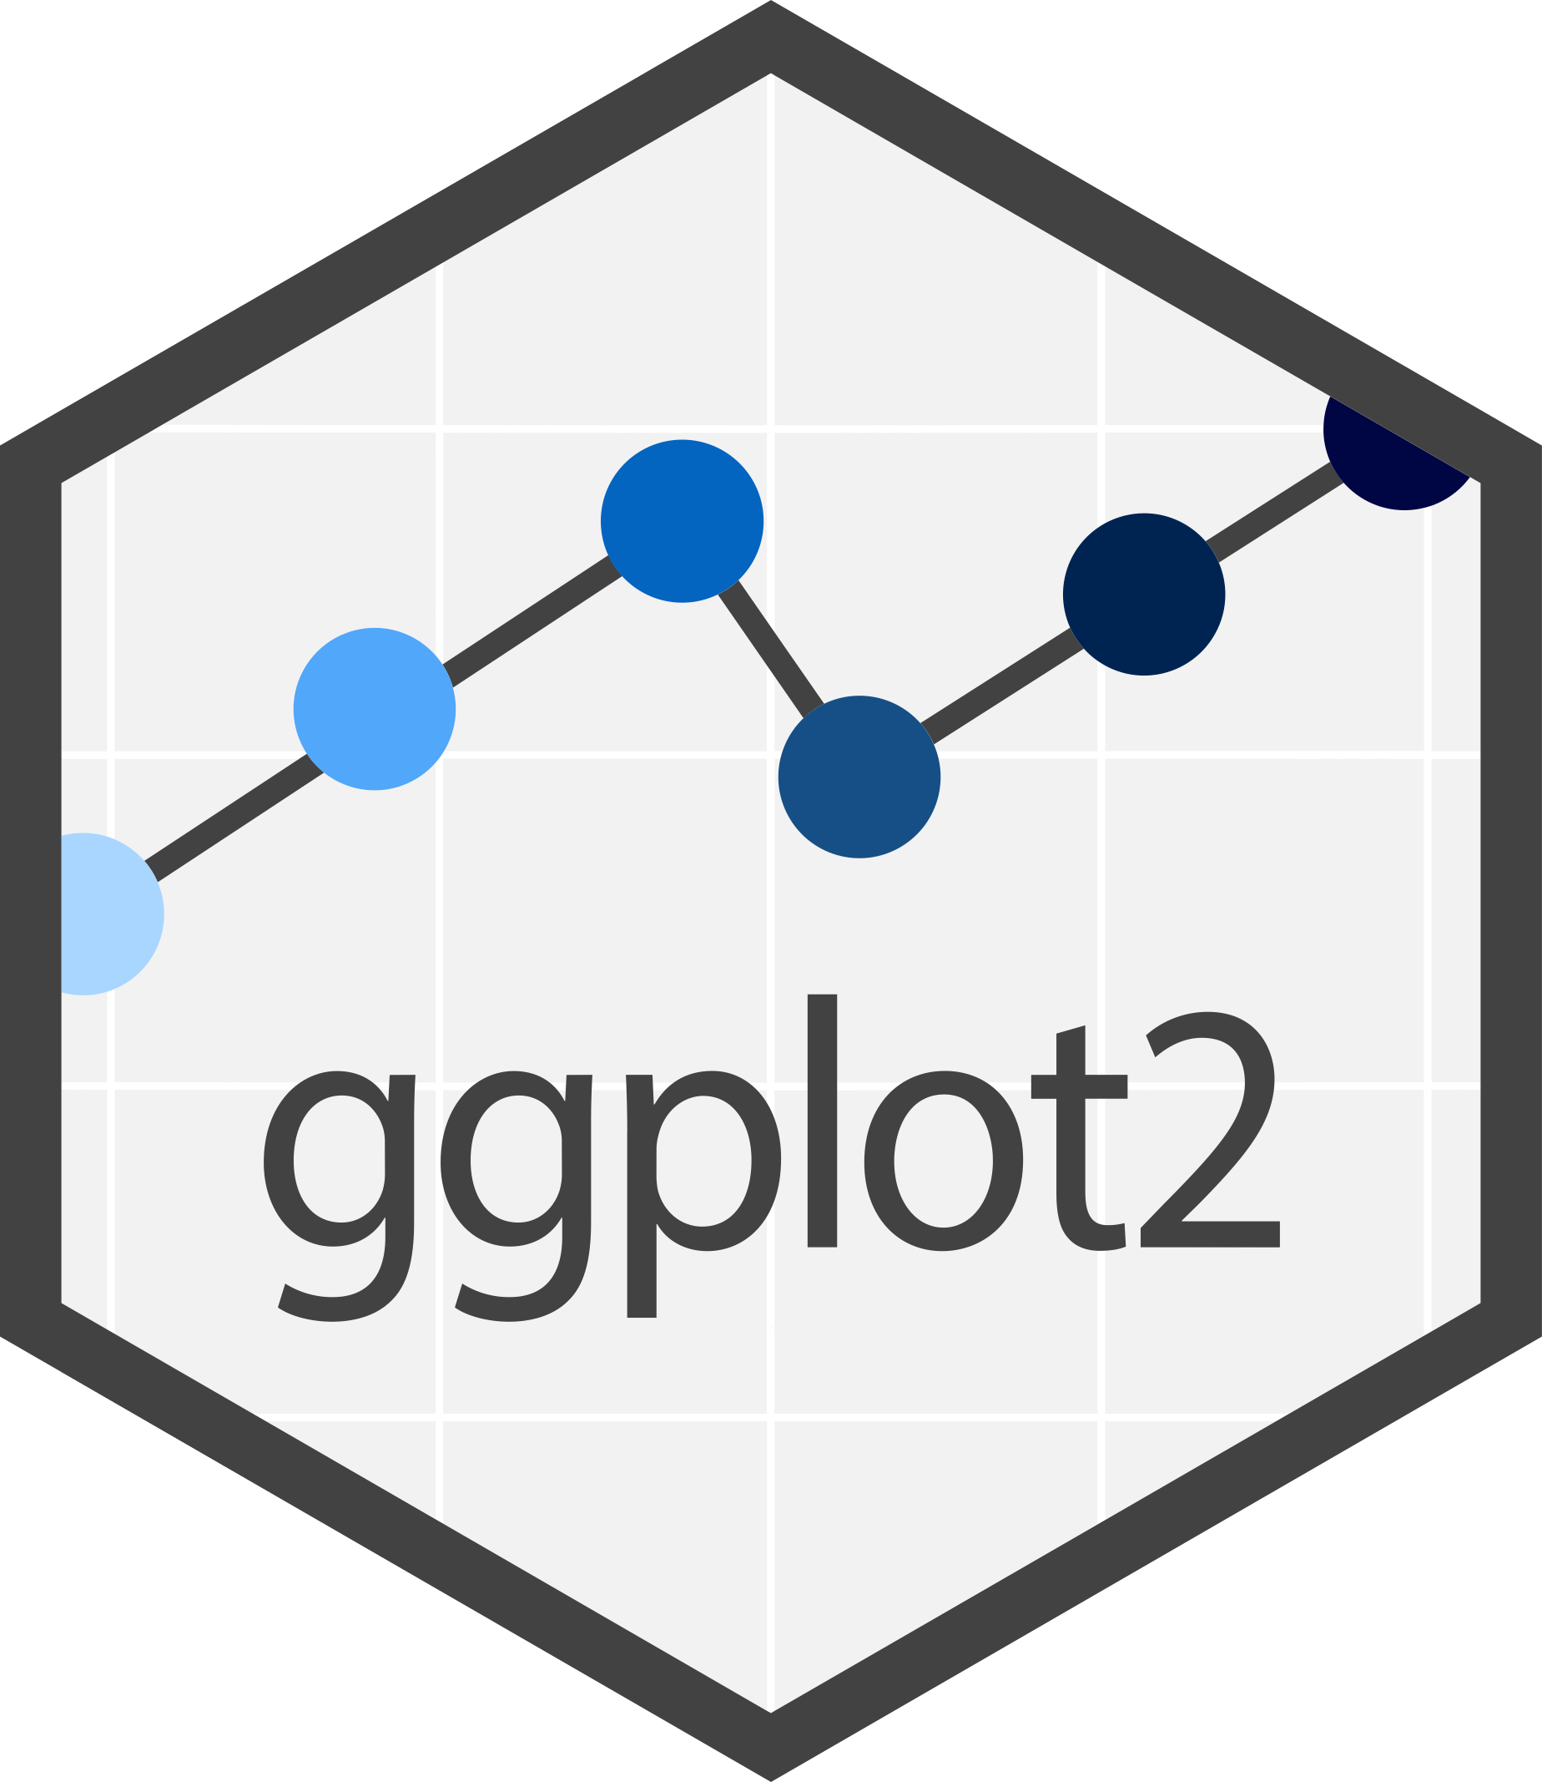
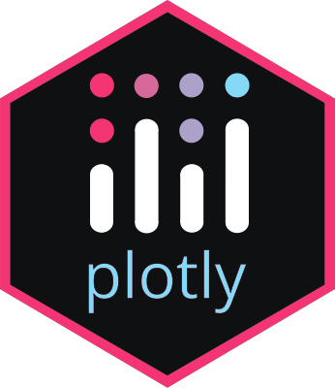
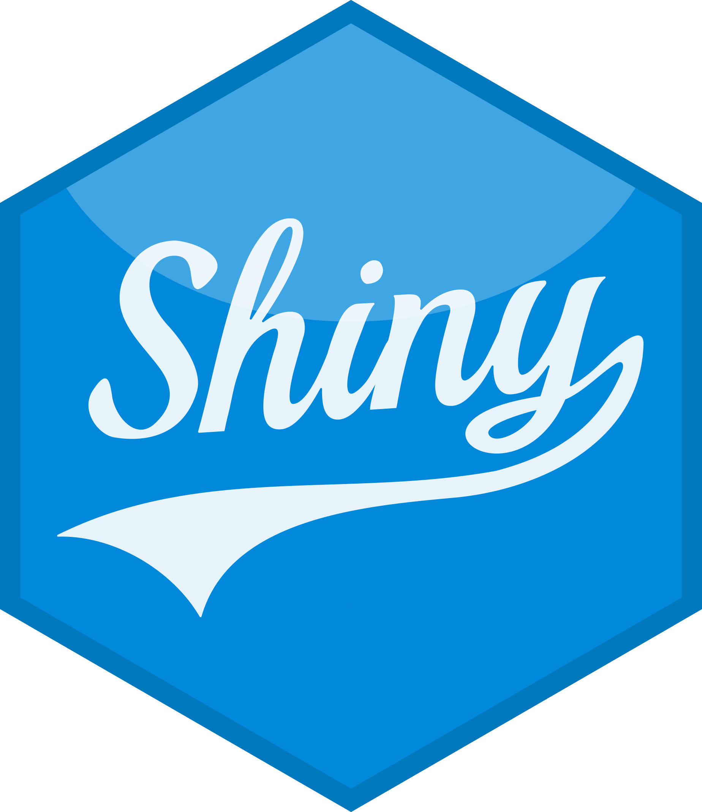
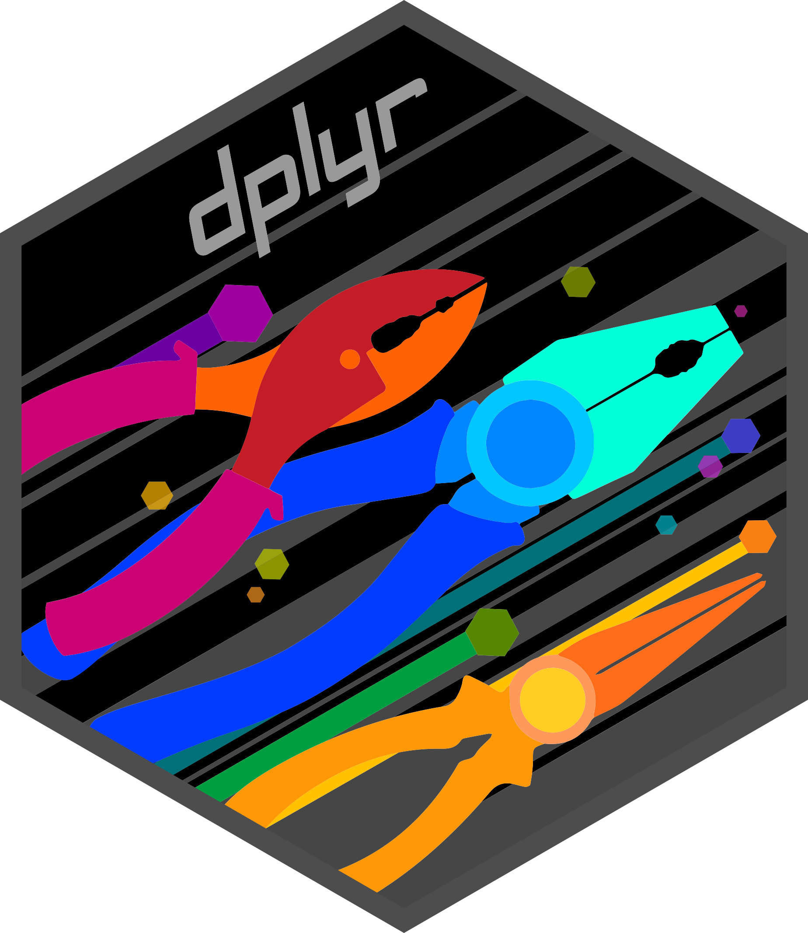
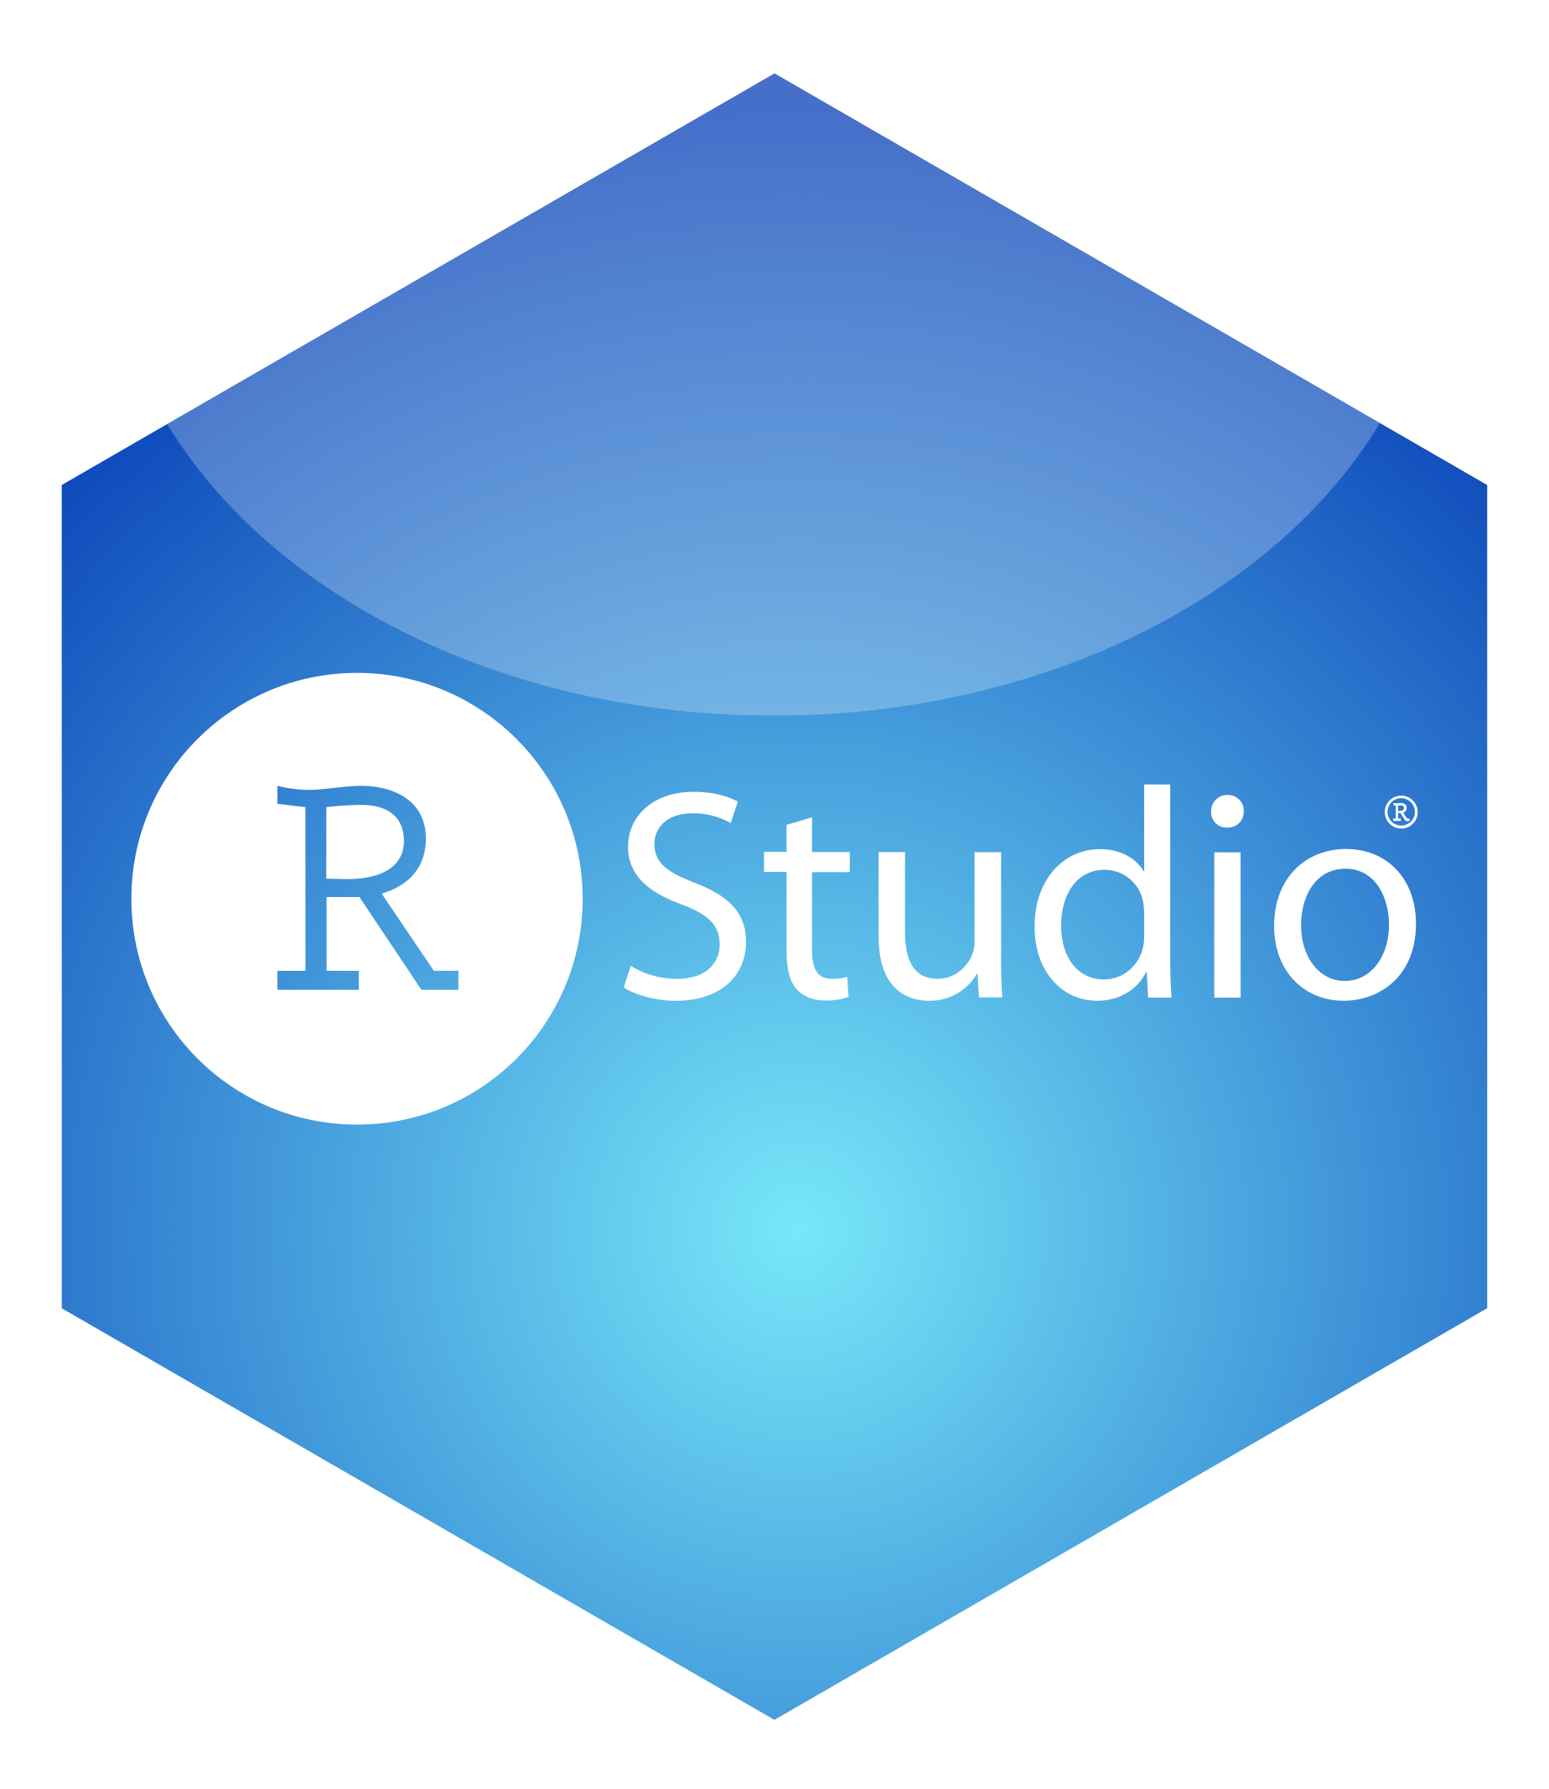
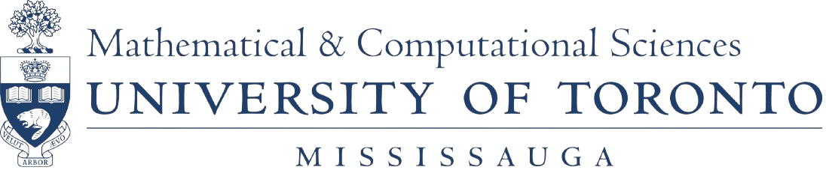


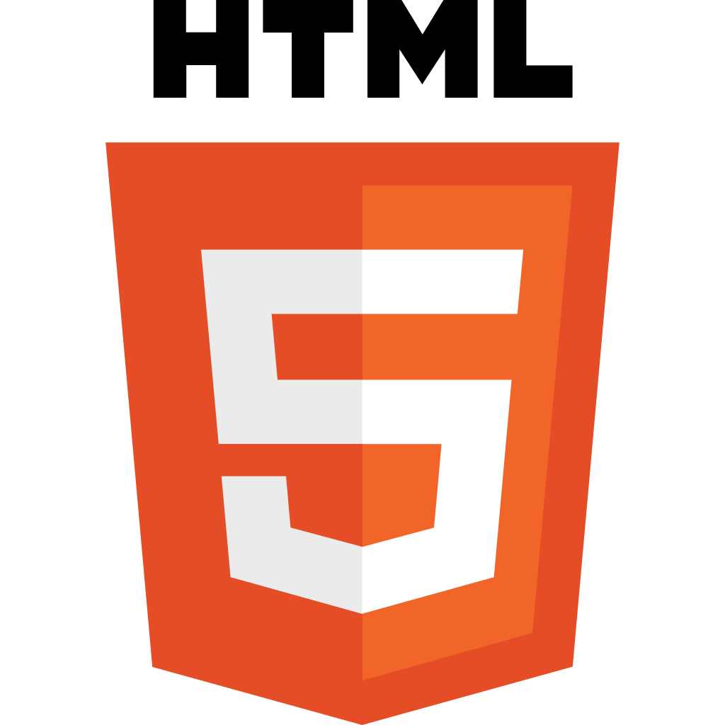


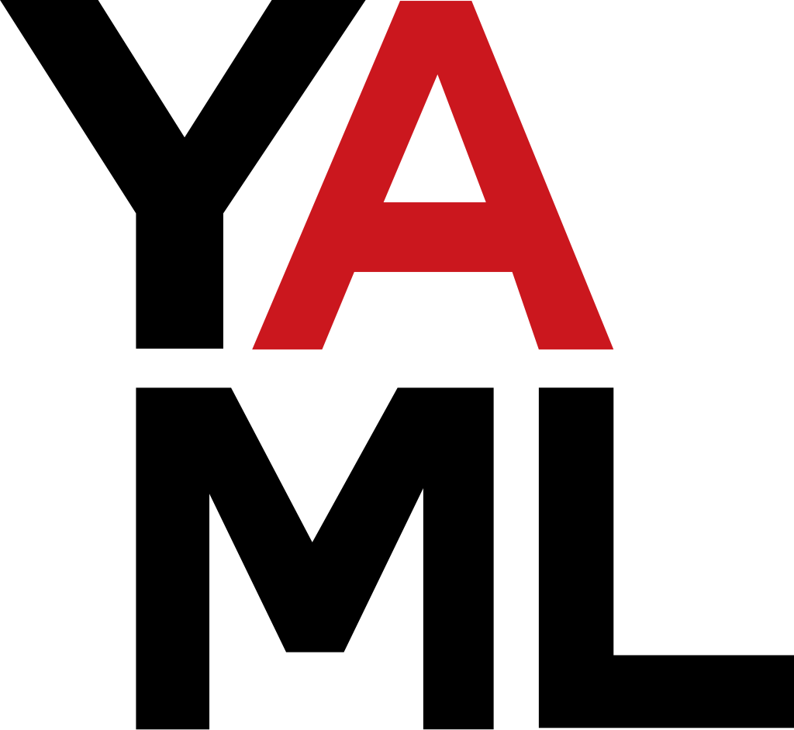
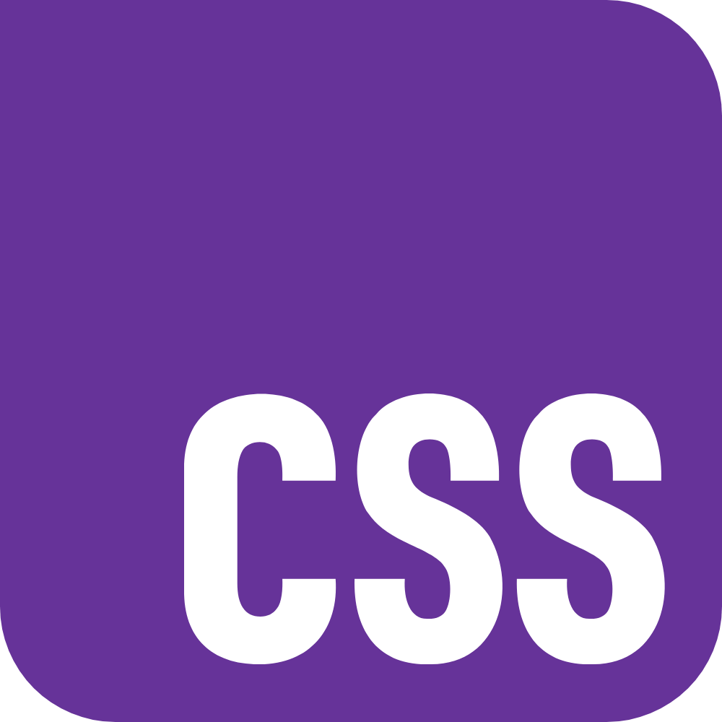
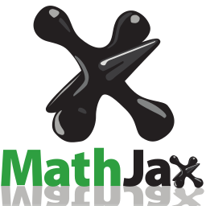
Student–Faculty Co-Creation of Open Educational Resources for Learning Applied Statistics with Open Source Software Tools
Nurlana Alili ¹, Xi (Bryan) Su ¹, Nishan Mudalige ¹, Masoud Ataei ¹
1 Department of Mathematical and Computational Sciences, University of Toronto Mississauga, Mississauga, ON L5L 1C6, Canada
Background and Introduction Student–faculty partnerships enhance learning by increasing engagement, motivation, and authenticity, yet such collaborations are rarely documented in statistics. To address this gap, students enrolled in STA378: Statistics Research Project co-created an e-book for STA258: Statistics with Applied Probability at UTM. The e-book integrates narrative text, simulations, visualizations, and interactive apps to modernize course content and reduce redundancy. Our project offers a practical model for student–faculty partnerships and forms part of a long-term redevelopment project for STA258.
Methodology and Implementation
The project was completed using open source tools. Content was written in Markdown and rendered using the Bookdown framework. Source files are managed on GitHub with the e-book hosted on GitHub Pages. Figures are rendered within code blocks and math statements are written in LaTeX within Markdown. Shiny applications are hosted on shinyapps.io and embedded directly in the e-book using HTML. Custom styling was implemented in CSS with formatting, metadata, and output options controlled using YAML.
Advantages of the Frameworks Used
Open source: Freely available to the broader community; actively maintained.
Self-contained: Text written in Markdown; figures rendered in code blocks.
Math-friendly: Math statements typeset in LaTeX are rendered with MathJax.
Interactive: Shiny apps embedded directly with simple HTML.
Customizable: Fonts, colors, and layouts modified through YAML and CSS.
Accessible: Dark mode, high-contrast mode, and quick search are embedded.
Integration: Plots, figures, and apps are rendered directly from R code blocks.
Version-control friendly: Maintained on GitHub, reproducible by design.
Affordable: E-book hosted on GitHub Pages (free); apps on shinyapps.io.
Future-proof: Sustained with open source tools and community contributions via forking and pull requests.
Results and Significance By leveraging open source software to build an accessible, interactive resource, we created a sustainable model others can adapt. Our experience demonstrates that participation in curriculum development can produce engaging materials while empowering students as active contributors. We also believe this is one of the few projects involving student–faculty co-creation of materials in statistics, and potentially one of the first projects of its kind in a Canadian context.
Languages | CSS, HTML, JavaScript, LaTeX, Markdown, R, YAML
Frameworks | Bookdown, R Markdown
R packages | bookdown, dplyr, ggplot2, knitr, plotly, rgl, Shiny
Version Control | Git (with GitHub)
Deployment | GitHub Pages, shinyapps.io
Table 1: Summary of languages, packages, frameworks, and other tools used do develop the e-book.
Figure 1: Landing page of the e-book. The hex sticker is an rgl object. The table of contents is on the left pane. The menu bar at the top contain accessibility options, has a search feature and can hide the table of contents (Also see Figure 6).
Figure 2: Examples of text content, including math statements and customized environments.
Available at https://nishanmudalige.github.io/STA258/
Figure 3: Example of an interactive application made with shiny to demonstrate the effect of bin widths on histograms.
Figure 4: Examples of static and interactive plots created with ggplot and plotly.
Figure 5: Example of an interactive application made with shiny to demonstrate correlation.
Figure 6: Accessibility and search features.
Figure 7: Examples of a code block and exercise with R.
Conclusions
Through this project, students learned the value of working across technical, design, and communication challenges in a collaborative setting with faculty and external partners. In addition to learning new skills, the experience introduced students to project management, and enhanced their creativity and problem-solving abilities beyond the classroom. The e-book serves as a course resource and a model for student involvement in shaping academic materials.
Roadmap for STA258 Course Redevelopment (Future work)
Acknowledgements
The authors thank Professors Nishan Mudalige (UTM) and Masoud Ataei (UTM) for their guidance; Dr. Steve Tully (Okanagan College, BC) and Ms. Avanti Coonghe (United Nations, UK) for feedback on content and design elements; the UTM Department of Mathematical and Computational Sciences for supporting student–faculty collaboration; and the open source community for tools and resources that made the project possible.
E-book
Interactive Tutorials
Problem Sets
Quizzes involving R
Slides + Shiny Apps
Summer 2025
Fall 2025
Winter 2026
Summer 2026
Fall 2026
References
Allaire J, Xie Y, Dervieux C, McPherson J, Luraschi J, Ushey K, Atkins A, Wickham H, Cheng J, Chang W, Iannone R (2024). rmarkdown: Dynamic Documents for R. R package version 2.29, https://github.com/rstudio/rmarkdown.
Chang W, Cheng J, Allaire J, Sievert C, Schloerke B, Xie Y, Allen J, McPherson J, Dipert A, Borges (2025). shiny: Web Application Framework for R. doi:10.32614/CRAN.package.shiny.
C. Sievert (2020). Interactive Web-Based Data Visualization with R, plotly, and shiny. Chapman and Hall/CRC.
Made with
References Ctd…
Wickham H (2016). ggplot2: Elegant Graphics for Data Analysis. Springer-Verlag.
Wickham H, François R, Henry L, Müller K, Vaughan D (2023). dplyr: A Grammar of Data Manipulation. doi:10.32614/CRAN.package.dplyr.
Xie Y (2025). bookdown: Authoring Books and Technical Documents with R Markdown. R package version 0.43. https://github.com/rstudio/bookdown.
Xie Y (2025). knitr: A General-Purpose Package for Dynamic Report Generation in R. R package version 1.50 https://yihui.org/knitr.
Available at https://nishanmudalige.github.io/STA258/
Made with
Conclusions
Through this project, students learned the value of working across technical, design, and communication challenges in a collaborative setting with faculty. In addition to learning new skills, the experience assisted students learn about project management, and improved their creativity and problem-solving abilities beyond the classroom. The e-book serves as a course resource and a model for how students can take an active role in shaping academic materials.
Acknowledgements
The authors thank Professors Nishan Mudalige (UTM) and Masoud Ataei (UTM) for their guidance, Dr. Steve Tully (Okanagan College, BC) and Ms. Avanti Coonghe (United Nations, UK) for feedback on content and design, the UTM Department of Mathematical and Computational Sciences for supporting student–faculty collaboration, and the open-source community for tools and resources that made the project possible.

